Slide 1
Chapter 23 Concurrency
Java How to Program, 11/e
Questions? E-mail paul.deitel@deitel.com

Slide 2
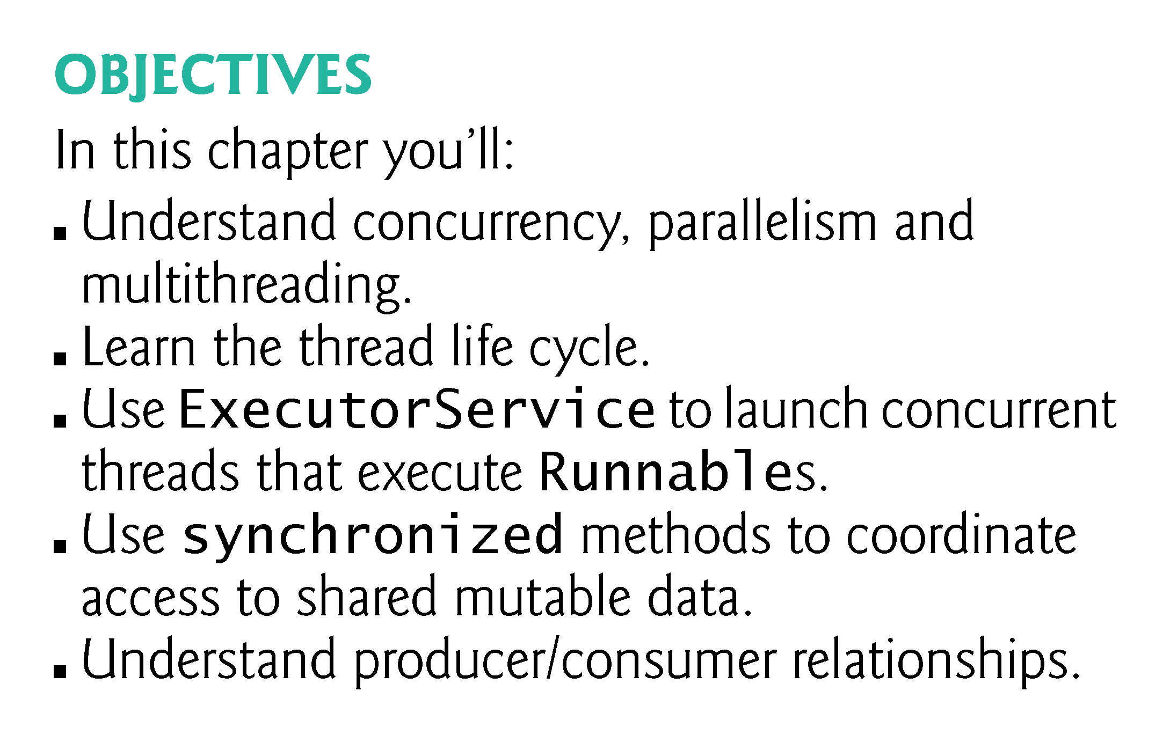

Slide 3
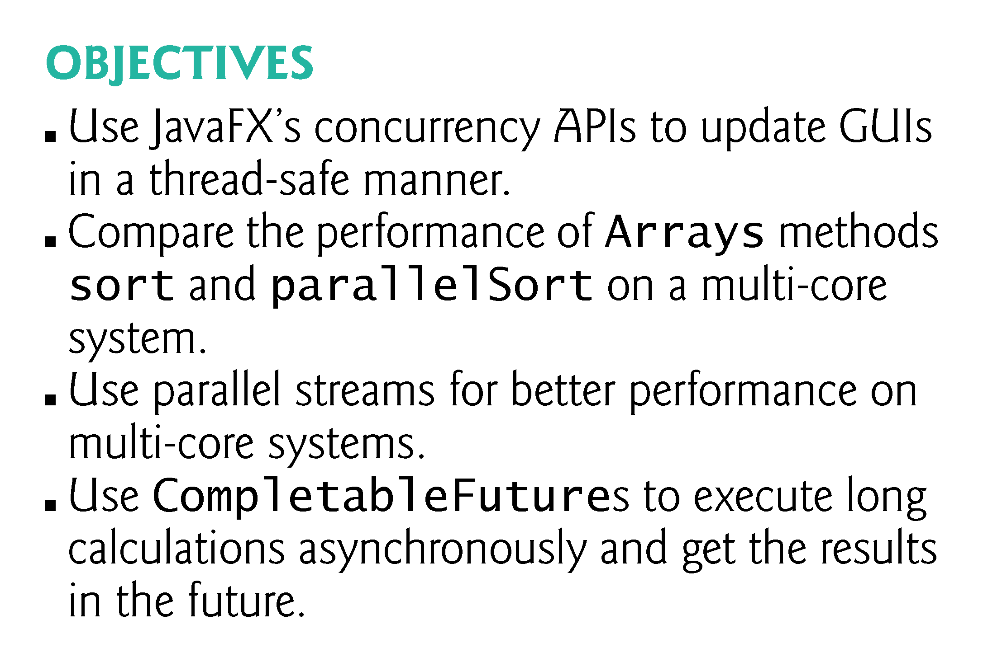

Slide 4
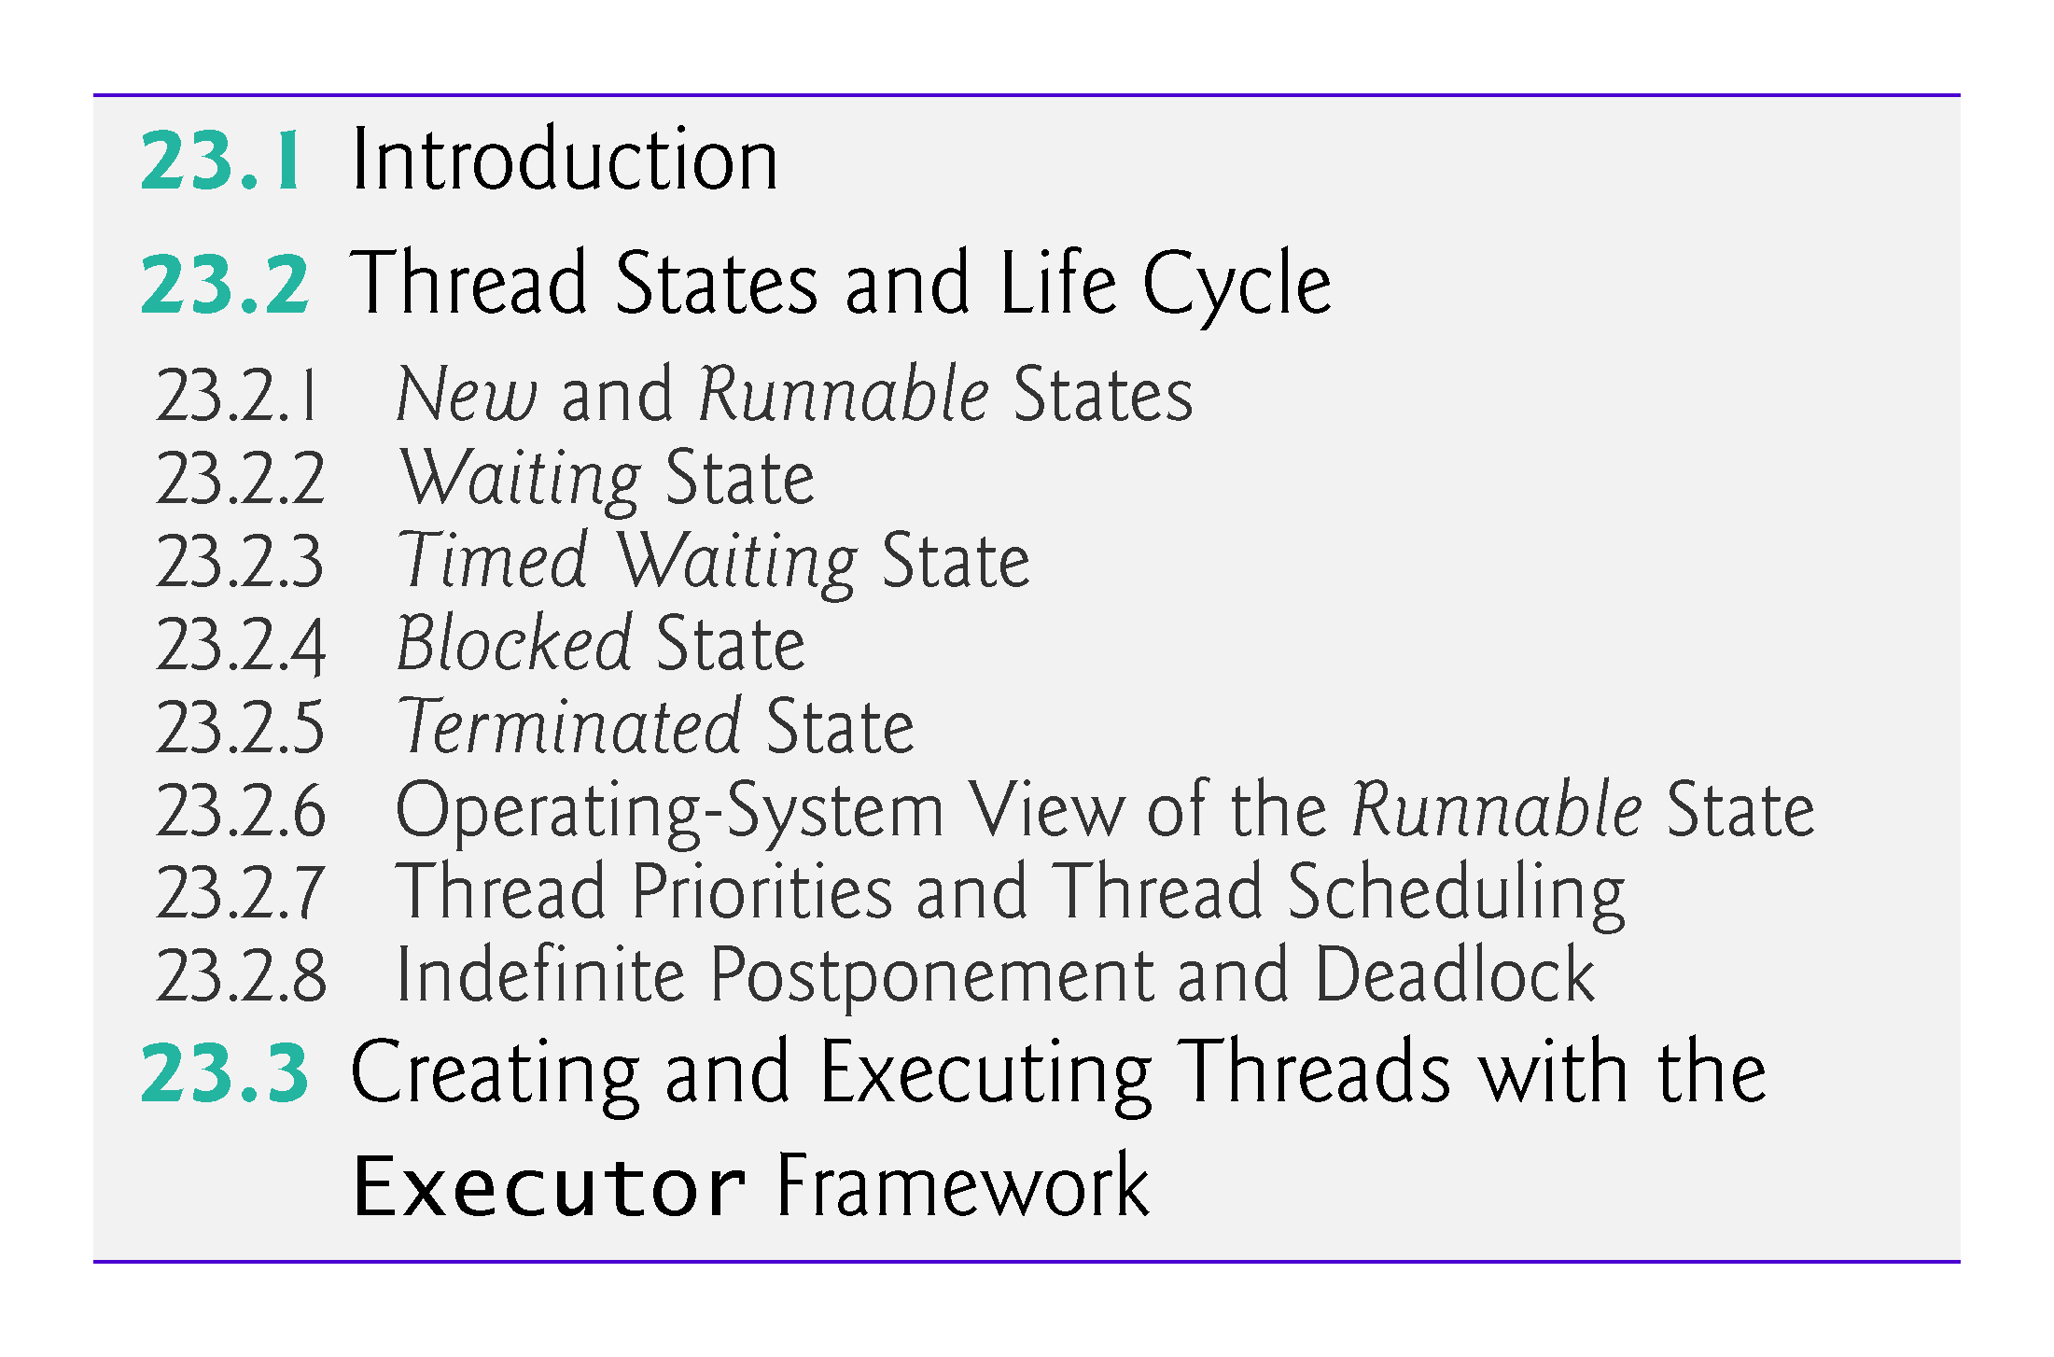

Slide 5
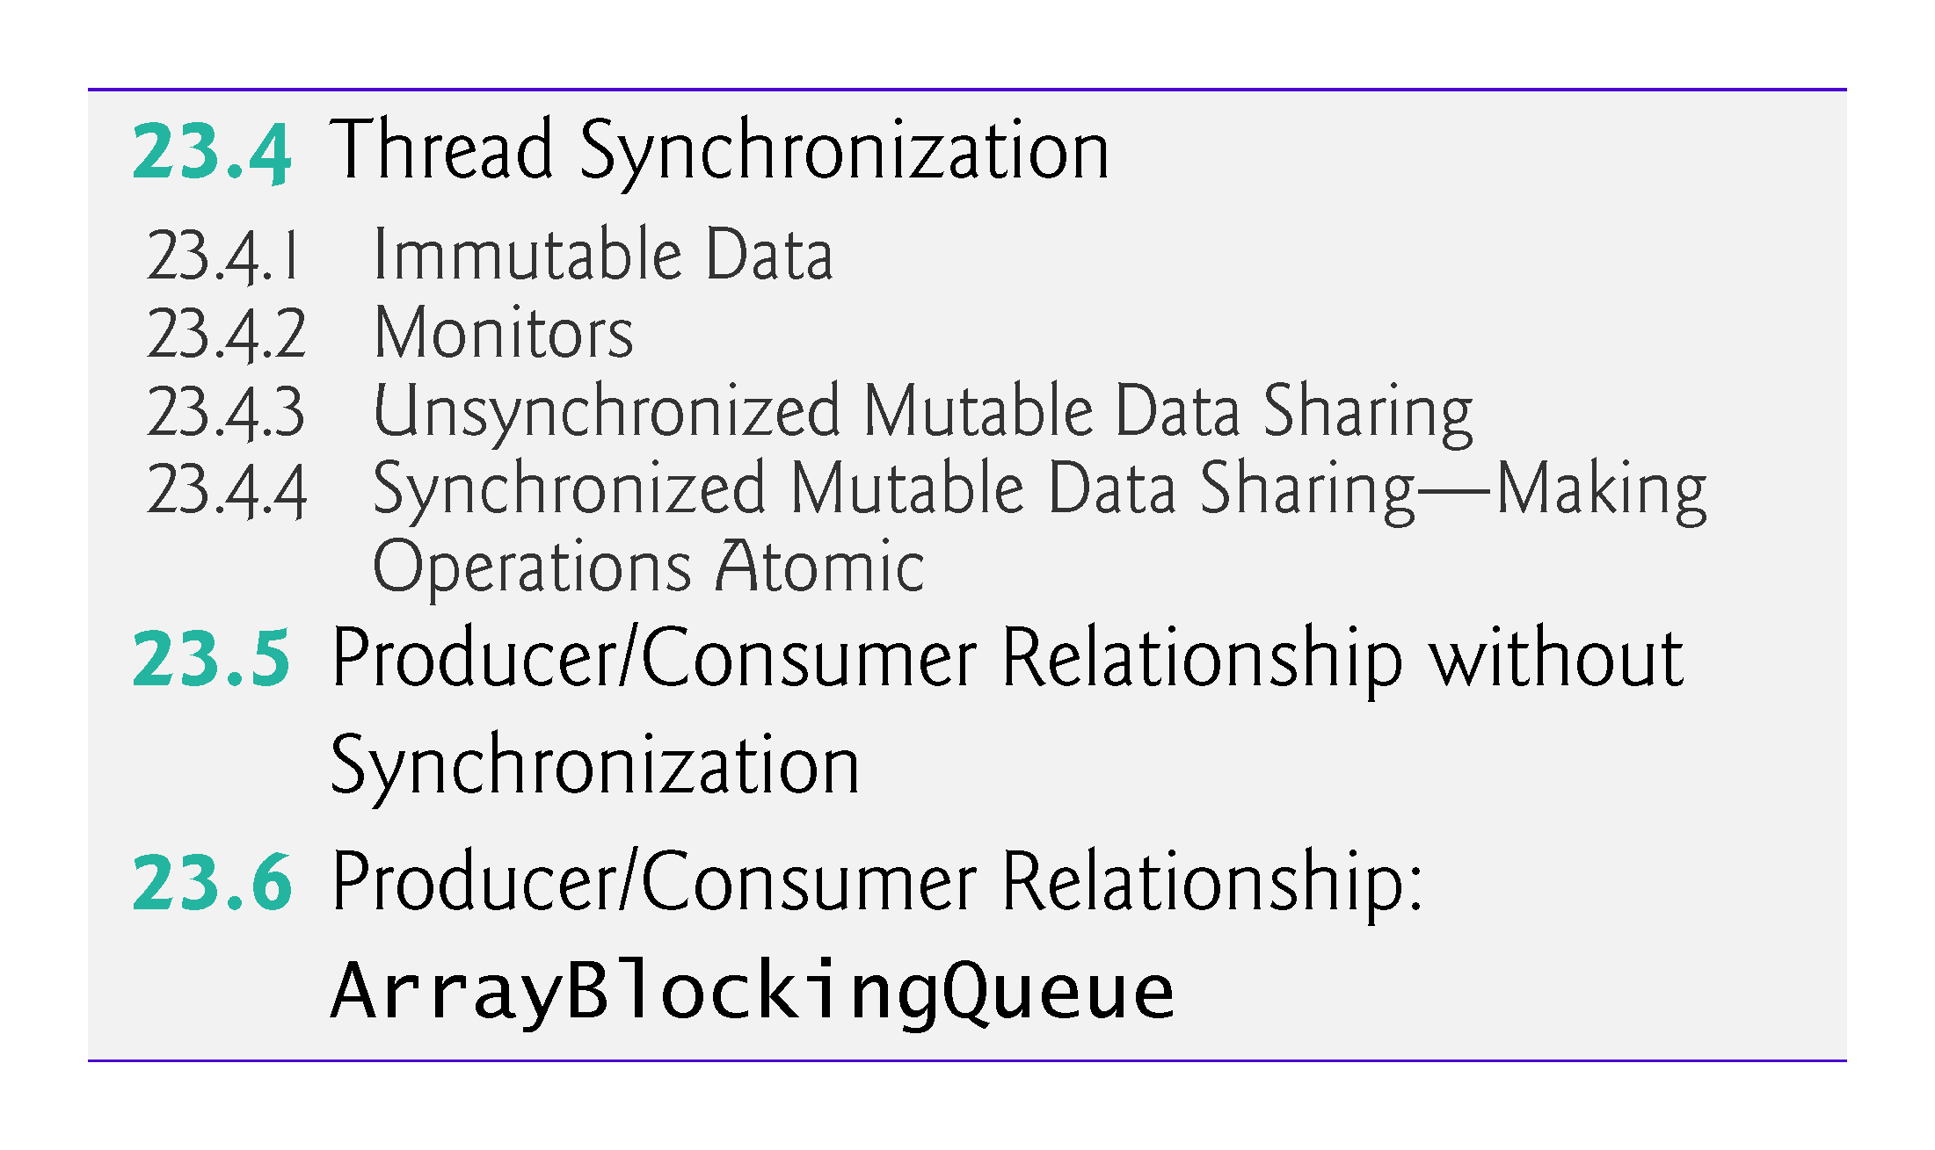

Slide 6
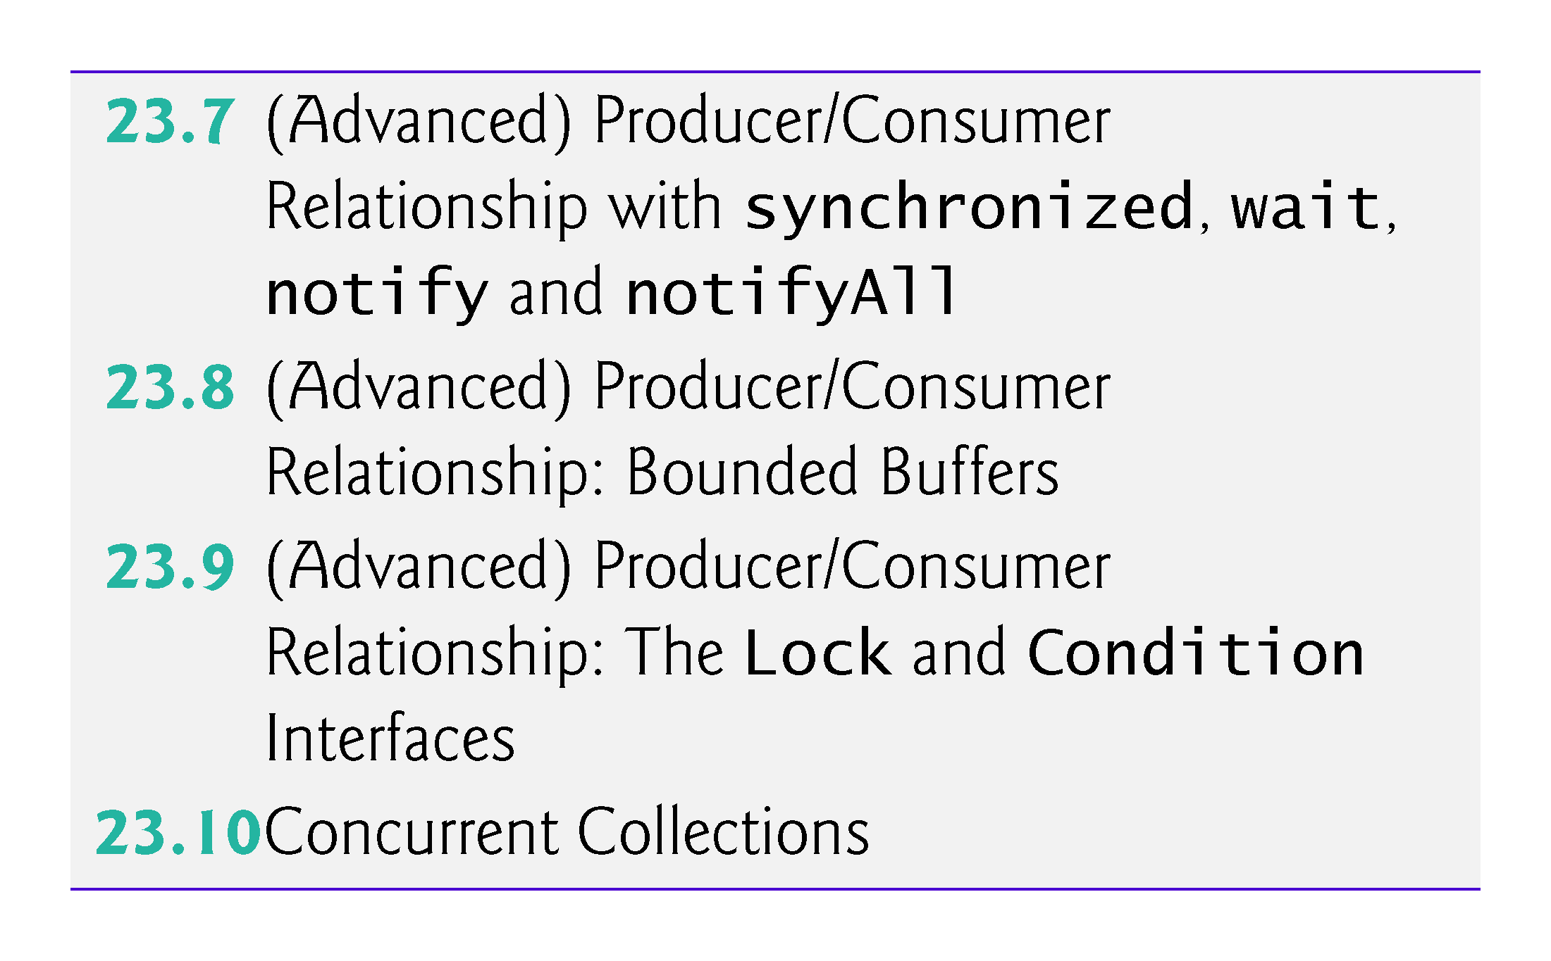

Slide 7
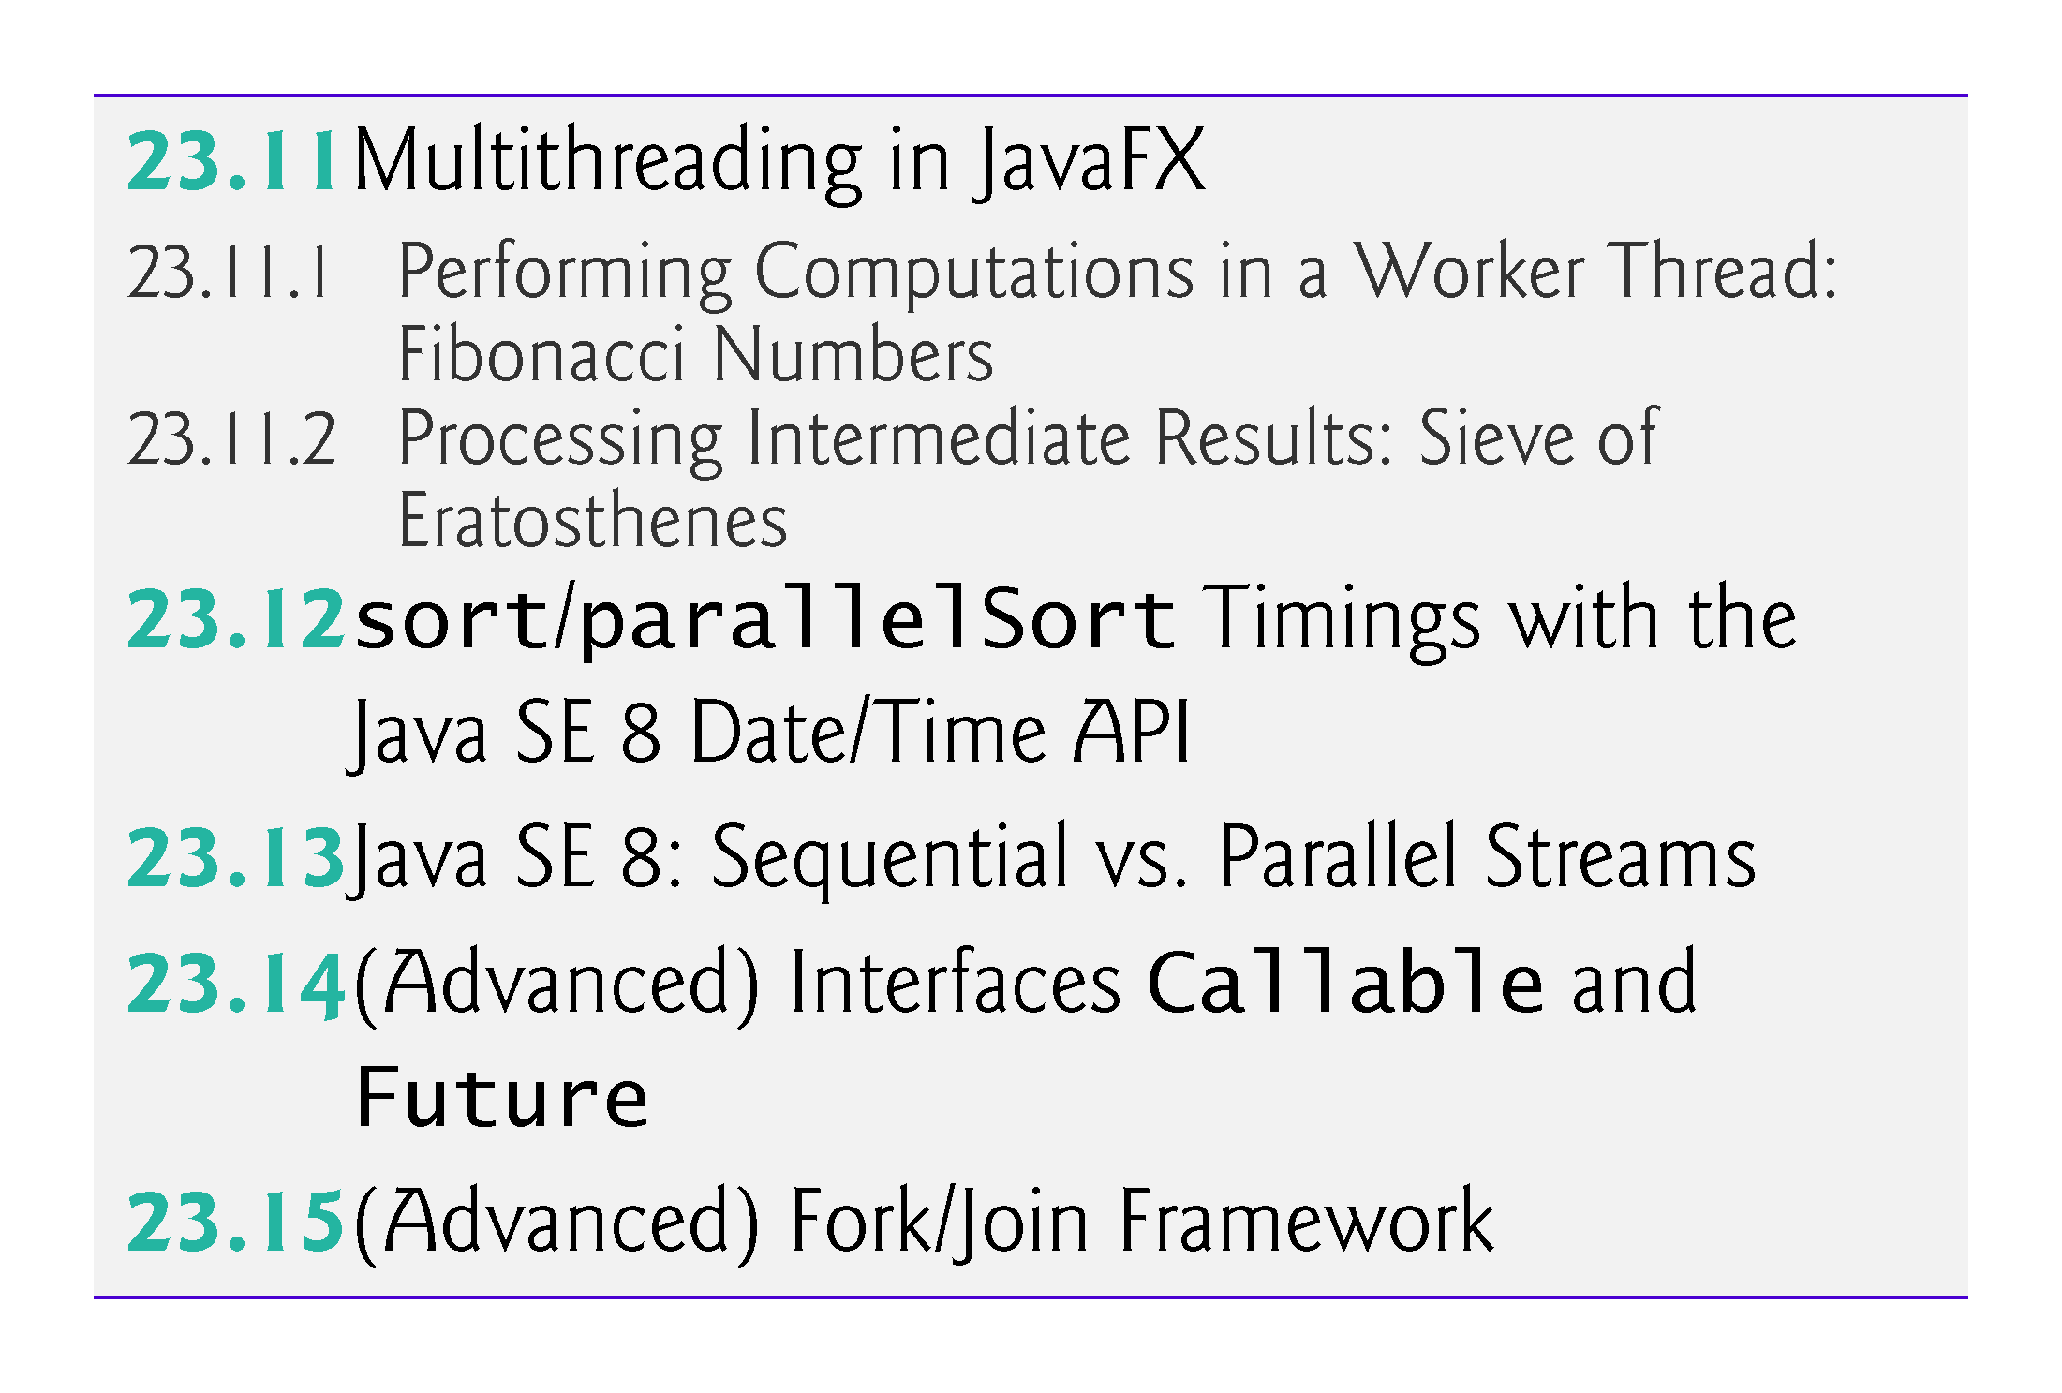

Slide 8
23.1 Introduction
When we say that two tasks are operating concurrently, we mean that they’re both making progress at once.
When we say that two tasks are operating in parallel, we mean that they’re executing simultaneously.
Java makes concurrency available to you through the language and APIs.
You specify that an application contains separate threads of execution
each thread has its own method-call stack and program counter
can execute concurrently with other threads while sharing application-wide resources such as memory and file handles.
This capability is called multithreading.

Slide 9
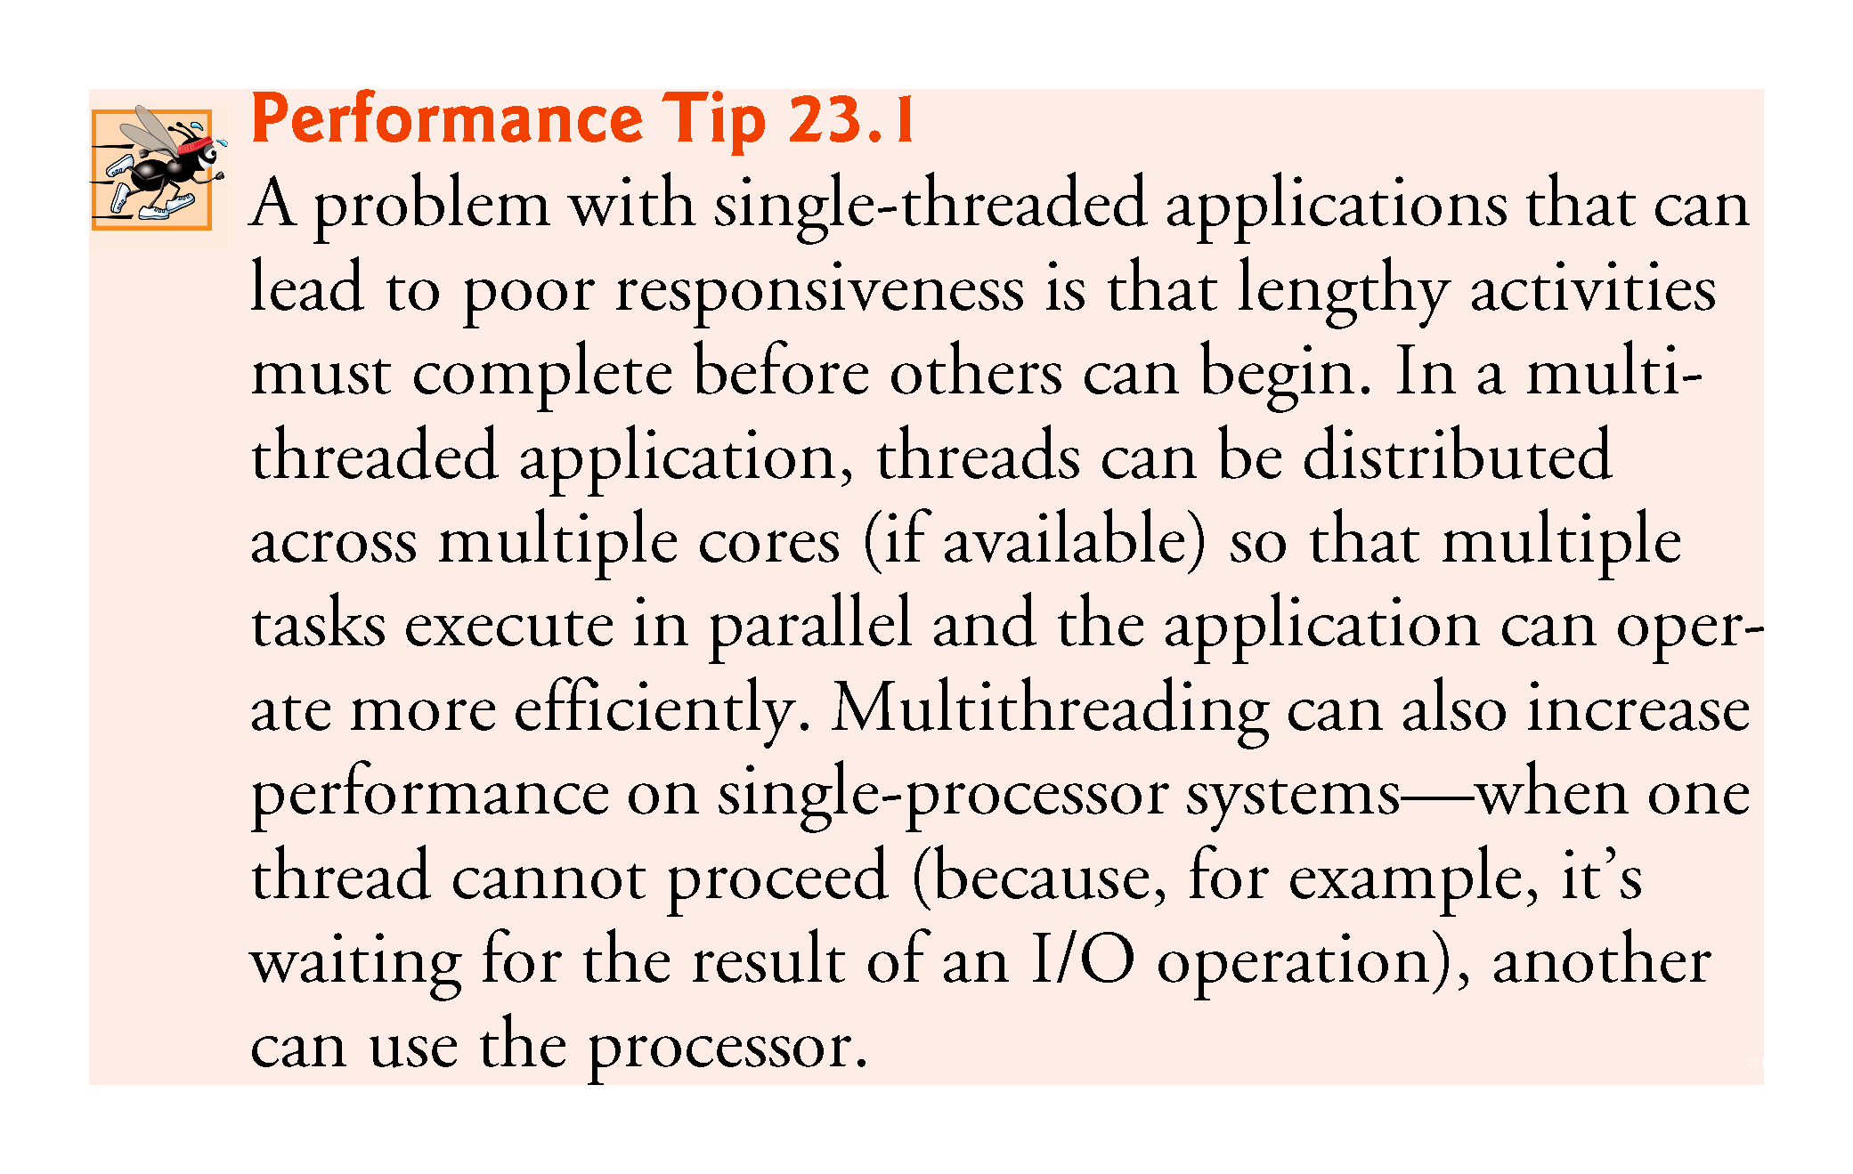

Slide 10
23.1 Introduction (cont.)
Programming concurrent applications is difficult and error prone.
Guidelines:
The vast majority of programmers should use existing collection classes and interfaces from the concurrency APIs that manage synchronization for you.
For advanced programmers who want to control synchronization, use the synchronized keyword and Object methods wait, notify and notifyAll.
Only the most advanced programmers should use Locks and Conditions

Slide 11
23.2 Thread States and Life Cycle
At any time, a thread is said to be in one of several thread states—illustrated in the UML state diagram in Fig. 23.1.

Slide 12
23.2.1 New and Runnable States
A new thread begins its life cycle in the new state.
Remains there until started, which places it in the runnable state—considered to be executing its task.

Slide 13
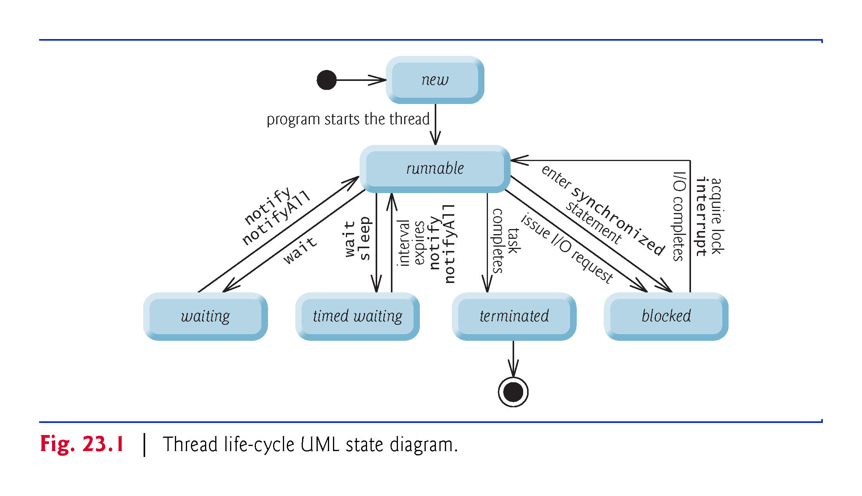

Slide 14
23.2.1 New and Runnable States
A new thread begins its life cycle in the new state.
Remains there until started, which places it in the runnable state—considered to be executing its task.

Slide 15
23.2.2 Waiting State
A runnable thread can transition to the waiting state while it waits for another thread to perform a task.
Transitions back to the runnable state only when another thread notifies it to continue executing.

Slide 16
23.2.3 Timed Waiting State
A runnable thread can enter the timed waiting state for a specified interval of time.
Transitions back to the runnable state when that time interval expires or when the event it’s waiting for occurs.
Cannot use a processor, even if one is available.
A sleeping thread remains in the timed waiting state for a designated period of time (called a sleep interval), after which it returns to the runnable state.

Slide 17
23.2.4 Blocked State
A runnable thread transitions to the blocked state when it attempts to perform a task that cannot be completed immediately and it must temporarily wait until that task completes.

Slide 18
23.2.5 Terminated State
A runnable thread enters the terminated state when it successfully completes its task or otherwise terminates (perhaps due to an error).

Slide 19
23.2.6 Operating-System View of the Runnable State
At the operating-system level, Java’s runnable state typically encompasses two separate states (Fig. 23.2).
When a thread first transitions to the runnable state from the new state, it is in the ready state.
A ready thread enters the running state (i.e., begins executing) when the operating system assigns it to a processor—also known as dispatching the thread.
Typically, each thread is given a a quantum or timeslice in which to perform its task.
The process that an operating system uses to determine which thread to dispatch is called thread scheduling.

Slide 20
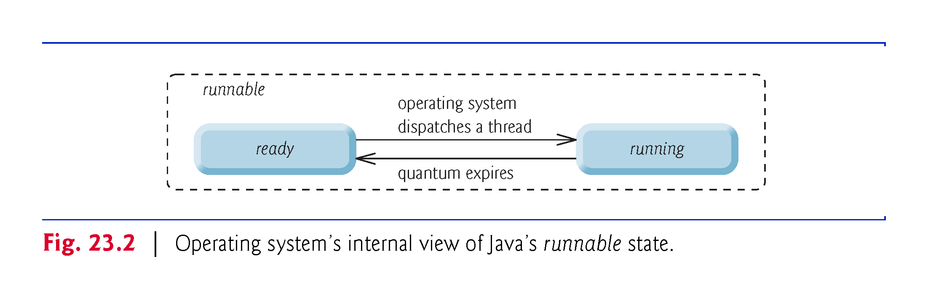

Slide 21
23.2.7 Thread Priorities and Thread Scheduling
Every Java thread has a thread priority that helps determine the order in which threads are scheduled.
Informally, higher-priority threads are more important to a program and should be allocated processor time before lower-priority threads.
Thread priorities cannot guarantee the order in which threads execute.
Do not explicitly create and use Thread objects to implement concurrency.
Rather, use the Executor interface (described in Section 23.3).

Slide 22
23.2.7 Thread Priorities and Thread Scheduling (Cont.)
Most operating systems support timeslicing, which enables threads of equal priority to share a processor.
An operating system’s thread scheduler determines which thread runs next.
One simple thread-scheduler implementation keeps the highest-priority thread running at all times and, if there’s more than one highest-priority thread, ensures that all such threads execute for a quantum each in round-robin fashion. This process continues until all threads run to completion.

Slide 23
23.2.8 Indefinite Postponement and Deadlock
When a higher-priority thread enters the ready state, the operating system generally preempts the currently running thread (an operation known as preemptive scheduling).
A steady influx of higher-priority threads could postpone—possibly indefinitely—the execution of lower-priority threads.
Indefinite postponement is sometimes referred to as starvation.
Operating systems employ a technique called aging to prevent starvation.

Slide 24
23.2.8 Indefinite Postponement and Deadlock (Cont.)
Another problem related to indefinite postponement is called deadlock.
This occurs when a waiting thread (let’s call this thread1) cannot proceed because it’s waiting (either directly or indirectly) for another thread (let’s call this thread2) to proceed, while simultaneously thread2 cannot proceed because it’s waiting (either directly or indirectly) for thread1 to proceed.
The two threads are waiting for each other, so the actions that would enable each thread to continue execution can never occur.

Slide 25
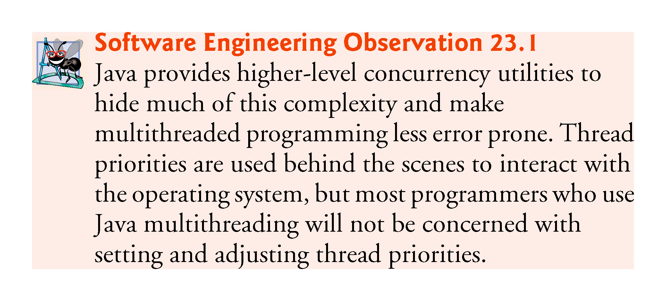

Slide 26
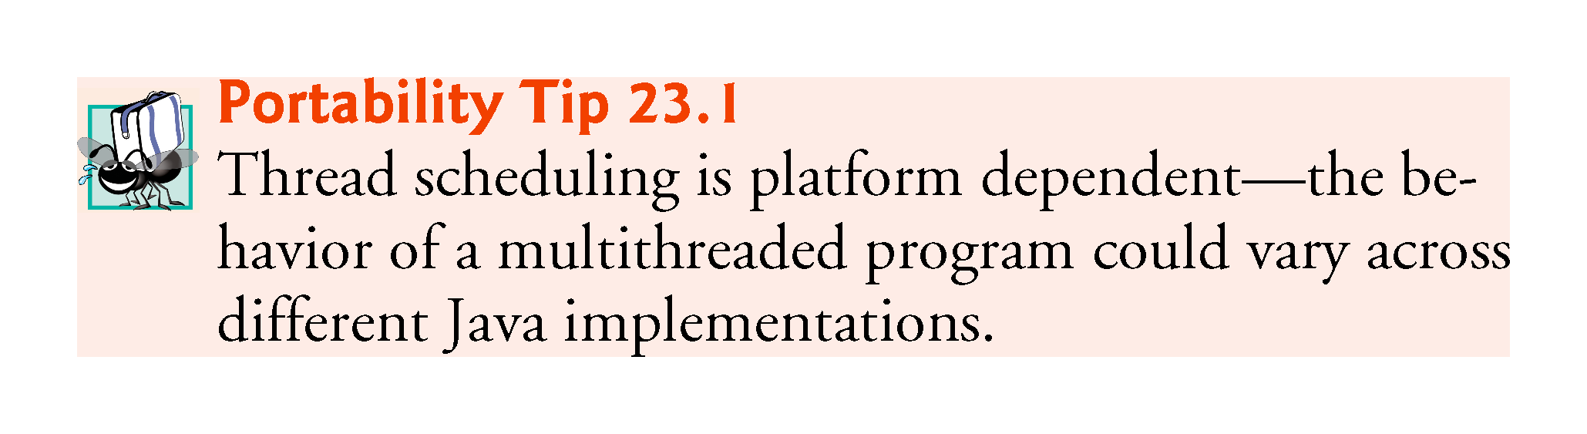

Slide 27
23.3 Creating and Executing Threads with the Executor Framework
A Runnable object represents a “task” that can execute concurrently with other tasks.
The Runnable interface declares the single method run, which contains the code that defines the task that a Runnable object should perform.
When a thread executing a Runnable is created and started, the thread calls the Runnable object’s run method, which executes in the new thread.

Slide 28
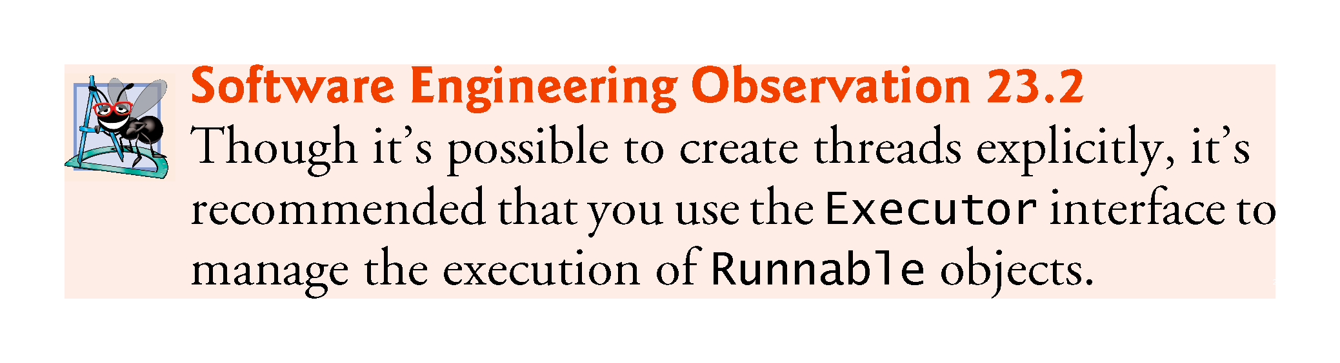

Slide 29
23.3 Creating and Executing Threads with the Executor Framework (cont.)
Class PrintTask (Fig. 23.3) implements Runnable, so that multiple PrintTasks can execute concurrently.
Thread static method sleep places a thread in the timed waiting state for the specified amount of time.
Can throw a checked exception of type InterruptedException if the sleeping thread’s interrupt method is called.
The code in main executes in the main thread, a thread created by the JVM.
The code in the run method of PrintTask executes in the threads created in main.
When method main terminates, the program itself continues running because there are still threads that are alive.
The program will not terminate until its last thread completes execution.

Slide 30
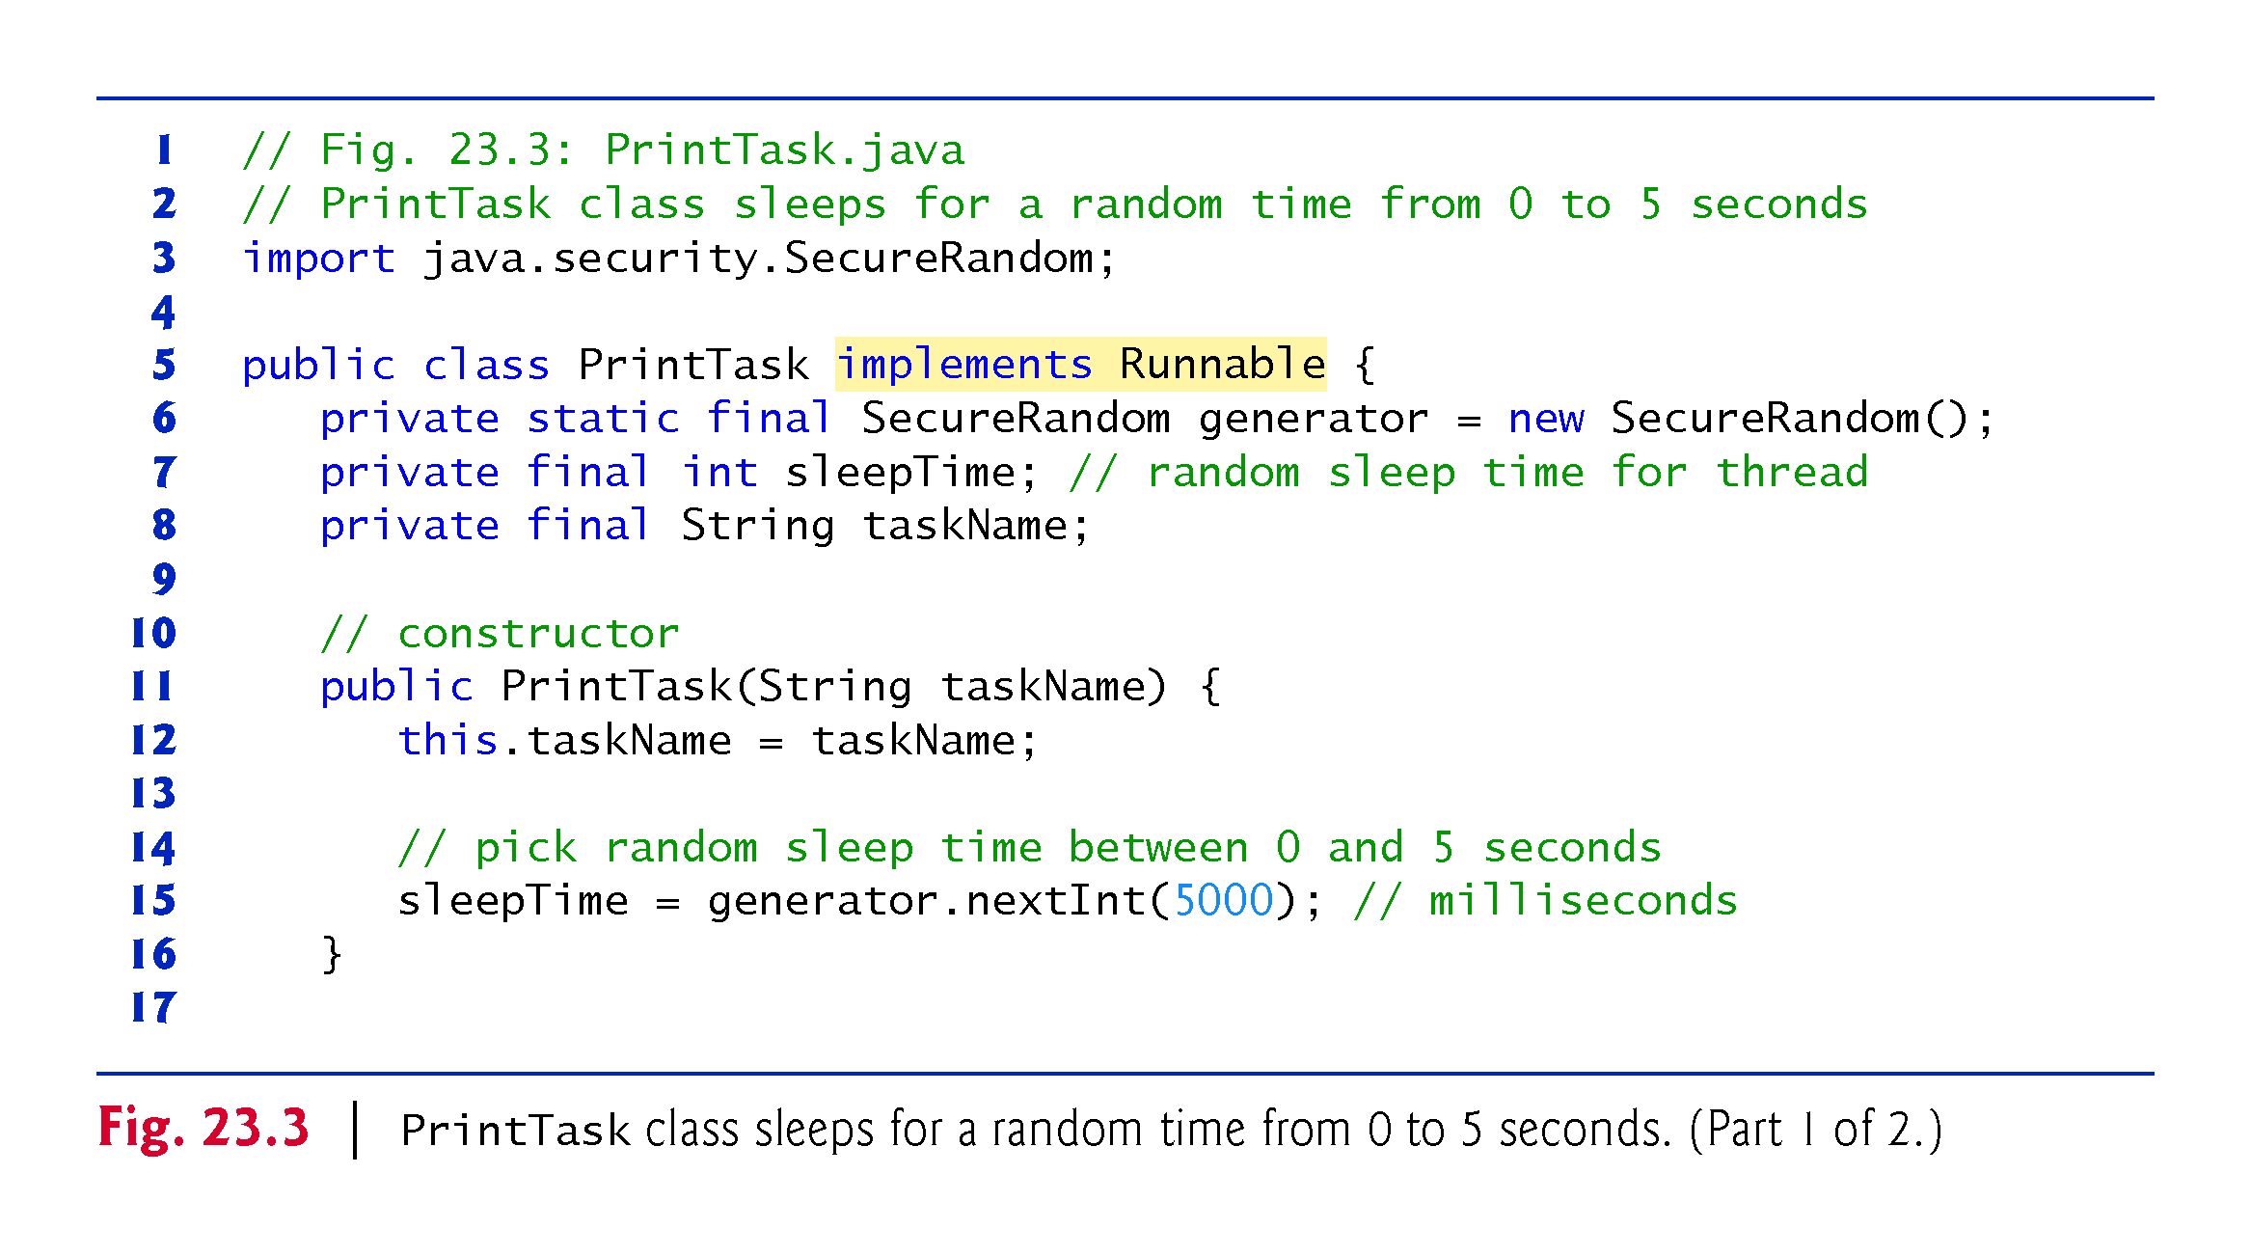

Slide 31
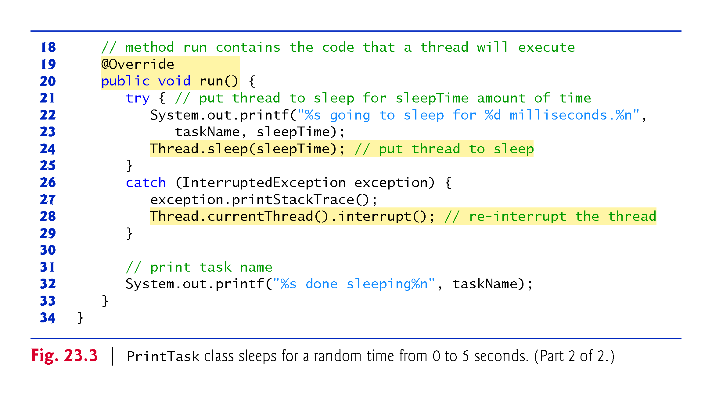

Slide 32
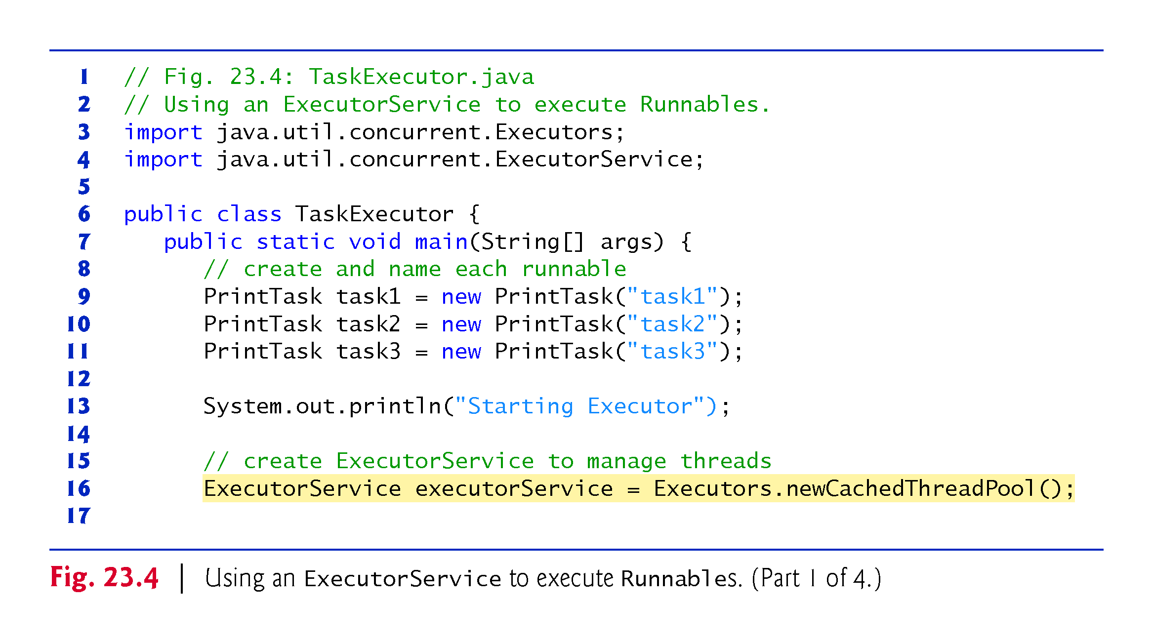

Slide 33
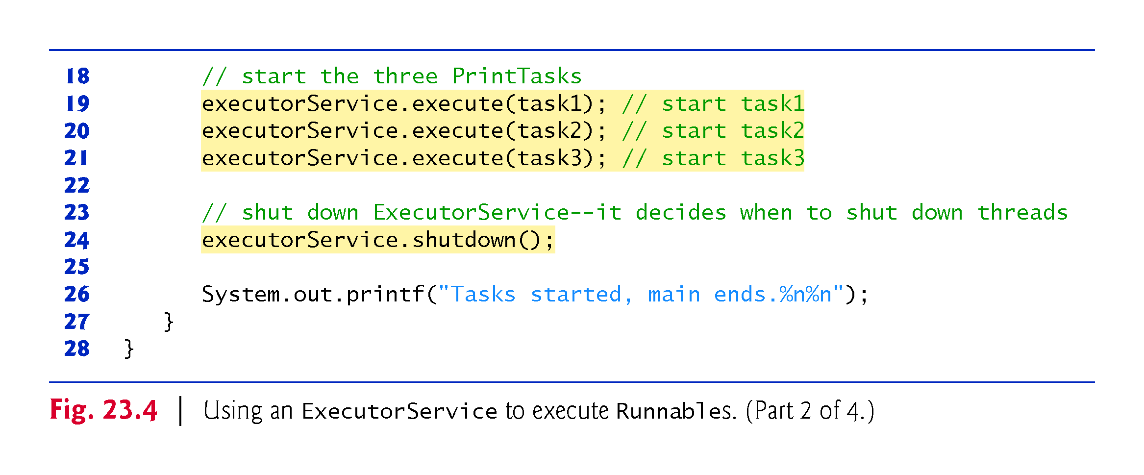

Slide 34
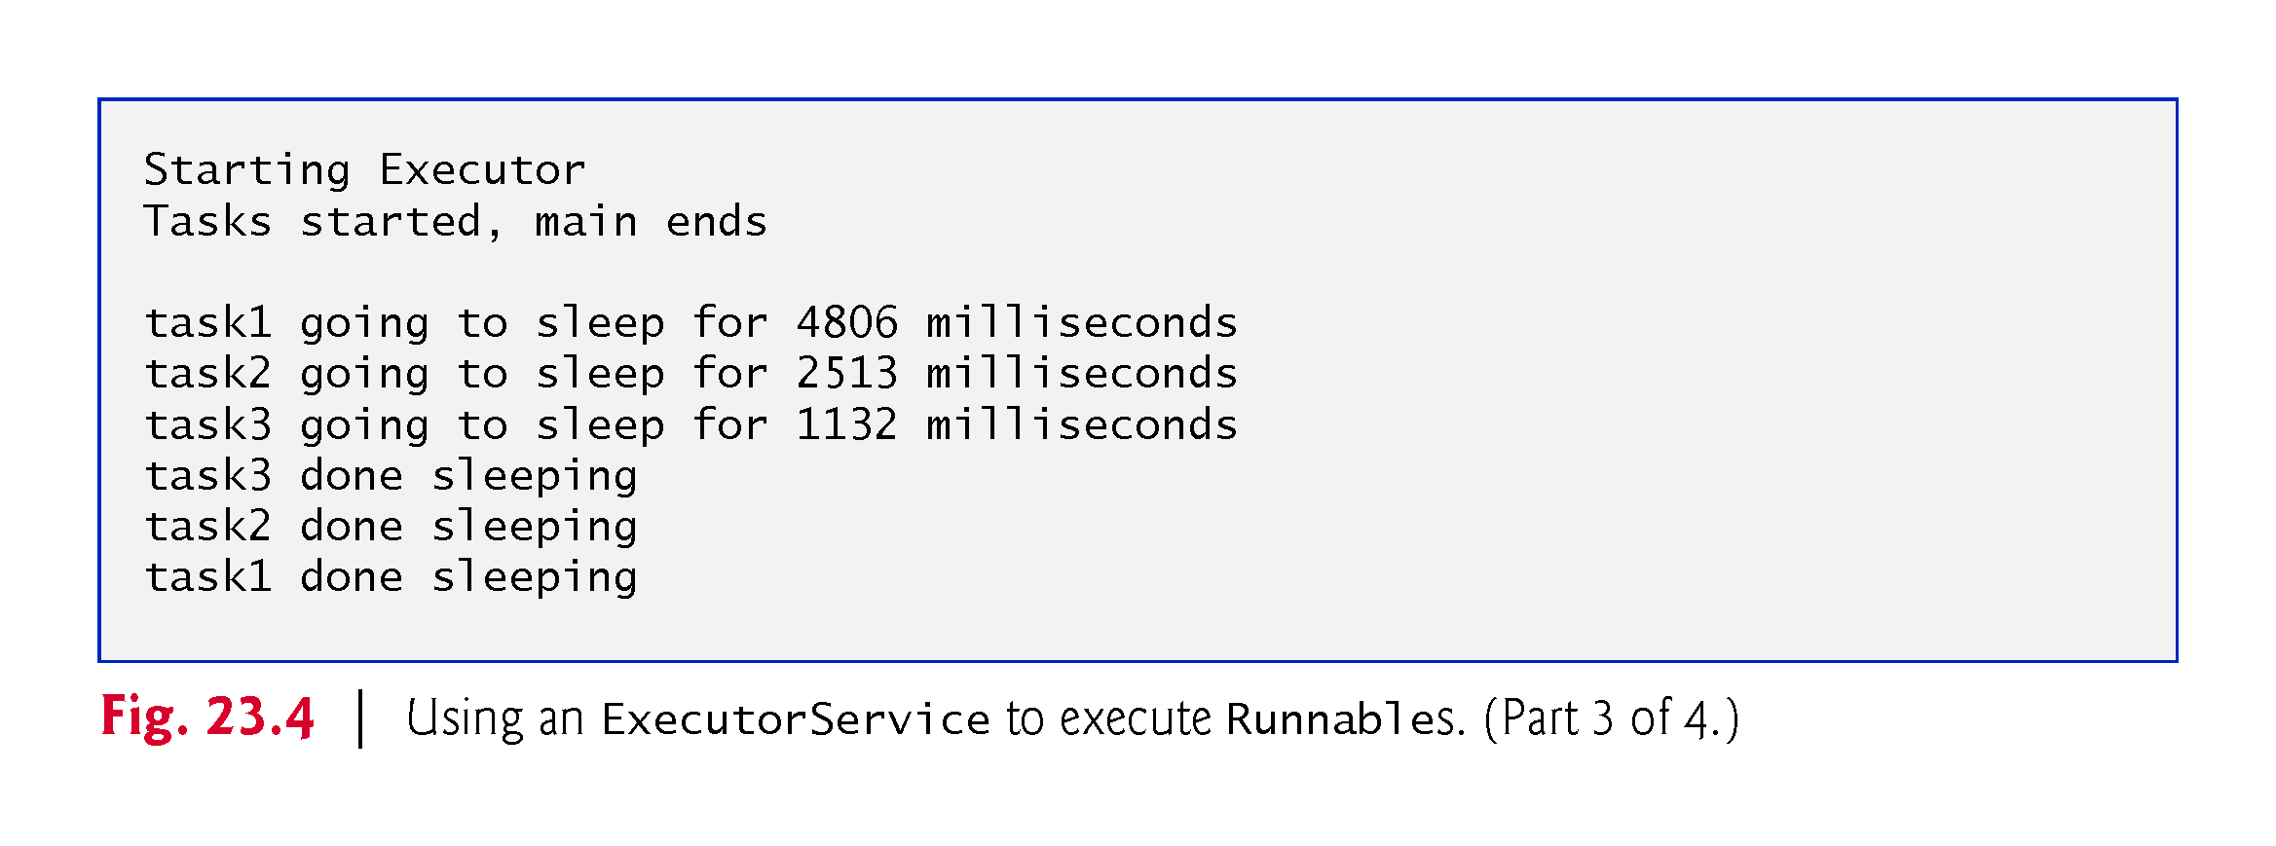

Slide 35
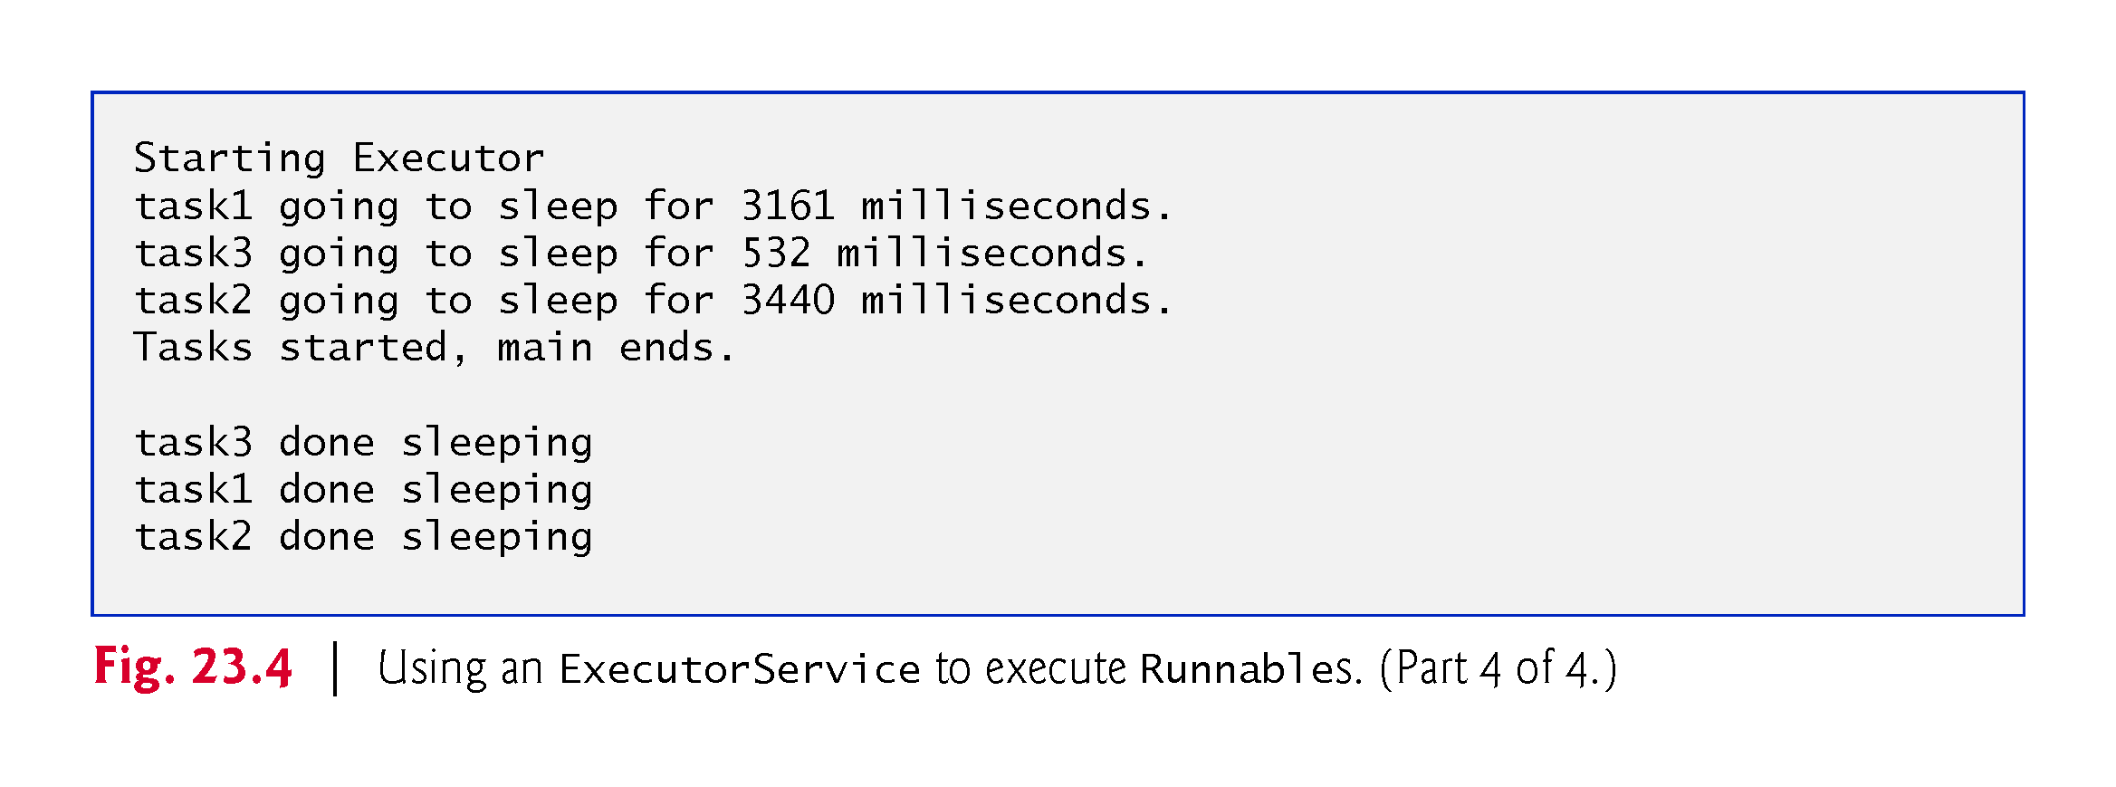

Slide 36
23.3 Creating and Executing Threads with the Executor Framework (cont.)
Recommended that you use the Executor interface to manage the execution of Runnable objects for you.
Typically creates and manages a group of threads called a thread pool to execute Runnables.
Executors can reuse existing threads and can improve performance by optimizing the number of threads.
Executor method execute accepts a Runnable as an argument.
An Executor assigns every Runnable passed to its execute method to one of the available threads in the thread pool.
If there are no available threads, the Executor creates a new thread or waits for a thread to become available.

Slide 37
23.3 Creating and Executing Threads with the Executor Framework (cont.)
The ExecutorService interface extends Executor and declares methods for managing the life cycle of an Executor.
An object that implements this interface can be created using static methods declared in class Executors.
Executors method newCachedThreadPool returns an ExecutorService that creates new threads as they’re needed by the application.
ExecutorService method shutdown notifies the ExecutorService to stop accepting new tasks, but continues executing tasks that have already been submitted.

Slide 38
23.4 Thread Synchronization
When multiple threads share an object and it is modified by one or more of them, indeterminate results may occur unless access to the shared object is managed properly.
The problem can be solved by giving only one thread at a time exclusive access to code that accesses the shared object.
During that time, other threads desiring to access the object are kept waiting.
When the thread with exclusive access finishes accessing the object, one of the waiting threads is allowed to proceed.
This process, called thread synchronization, coordinates access to shared data by multiple concurrent threads.
Ensures that each thread accessing a shared object excludes all other threads from doing so simultaneously—this is called mutual exclusion.

Slide 39
23.4.1 Immutable Data
Thread synchronization is necessary only for shared mutable data, i.e., data that may change during its lifetime.
With shared immutable data that will not change, it’s not possible for a thread to see old or incorrect values as a result of another thread’s manipulation of that data.
When you share immutable data across threads, declare the corresponding data fields final to indicate that the values of the variables will not change after they’re initialized.
Labeling object references as final indicates that the reference will not change, but it does not guarantee that the referenced object is immutable—this depends entirely on the object’s properties.
However, it’s still good practice to mark references that will not change as final.

Slide 40
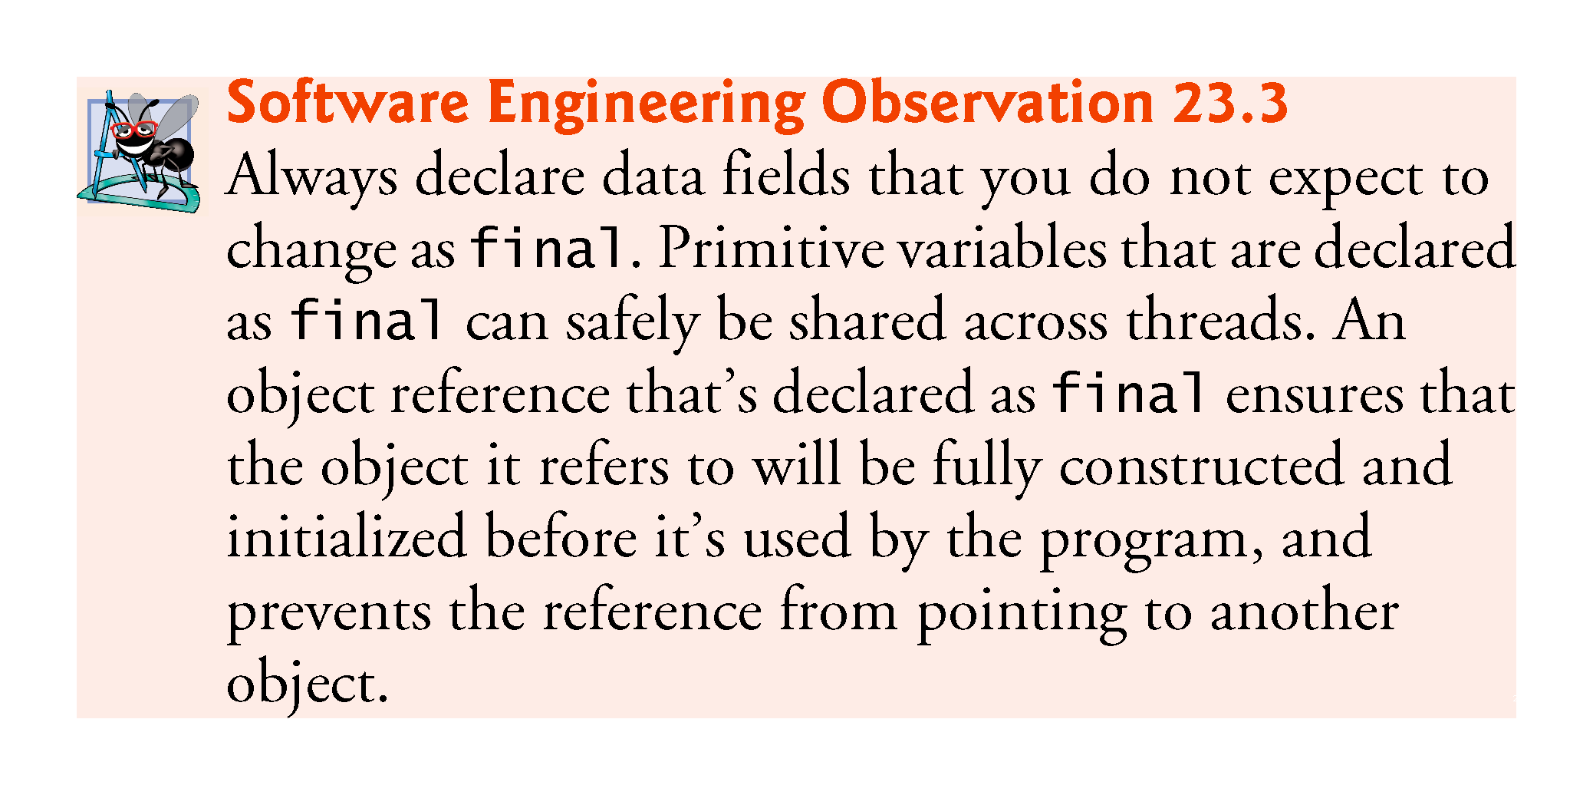

Slide 41
23.4.2 Monitors
A common way to perform synchronization is to use Java’s built-in monitors.
Every object has a monitor and a monitor lock (or intrinsic lock).
Can be held by a maximum of only one thread at any time.
A thread must acquire the lock before proceeding with the operation.
Other threads attempting to perform an operation that requires the same lock will be blocked.
To specify that a thread must hold a monitor lock to execute a block of code, the code should be placed in a synchronized statement.
Said to be guarded by the monitor lock

Slide 42
23.4.2 Monitors (Cont.)
The synchronized statements are declared using the synchronized keyword:
synchronized (object) { statements } // end synchronized statement
where object is the object whose monitor lock will be acquired
object is normally this if it’s the object in which the synchronized statement appears.
When a synchronized statement finishes executing, the object’s monitor lock is released.
Java also allows synchronized methods.

Slide 43
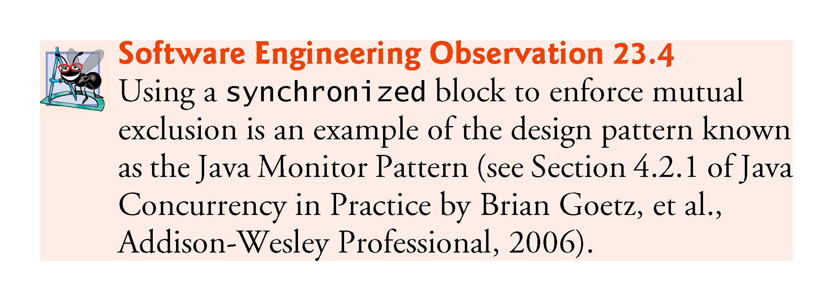

Slide 44
23.4.3 Unsynchronized Mutable Data Sharing
A SimpleArray object (Fig. 23.5) will be shared across multiple threads.
Will enable those threads to place int values into array.
Puts the thread that invokes add to sleep for a random interval from 0 to 499 milliseconds.
This is done to make the problems associated with unsynchronized access to shared mutable data more obvious.

Slide 45
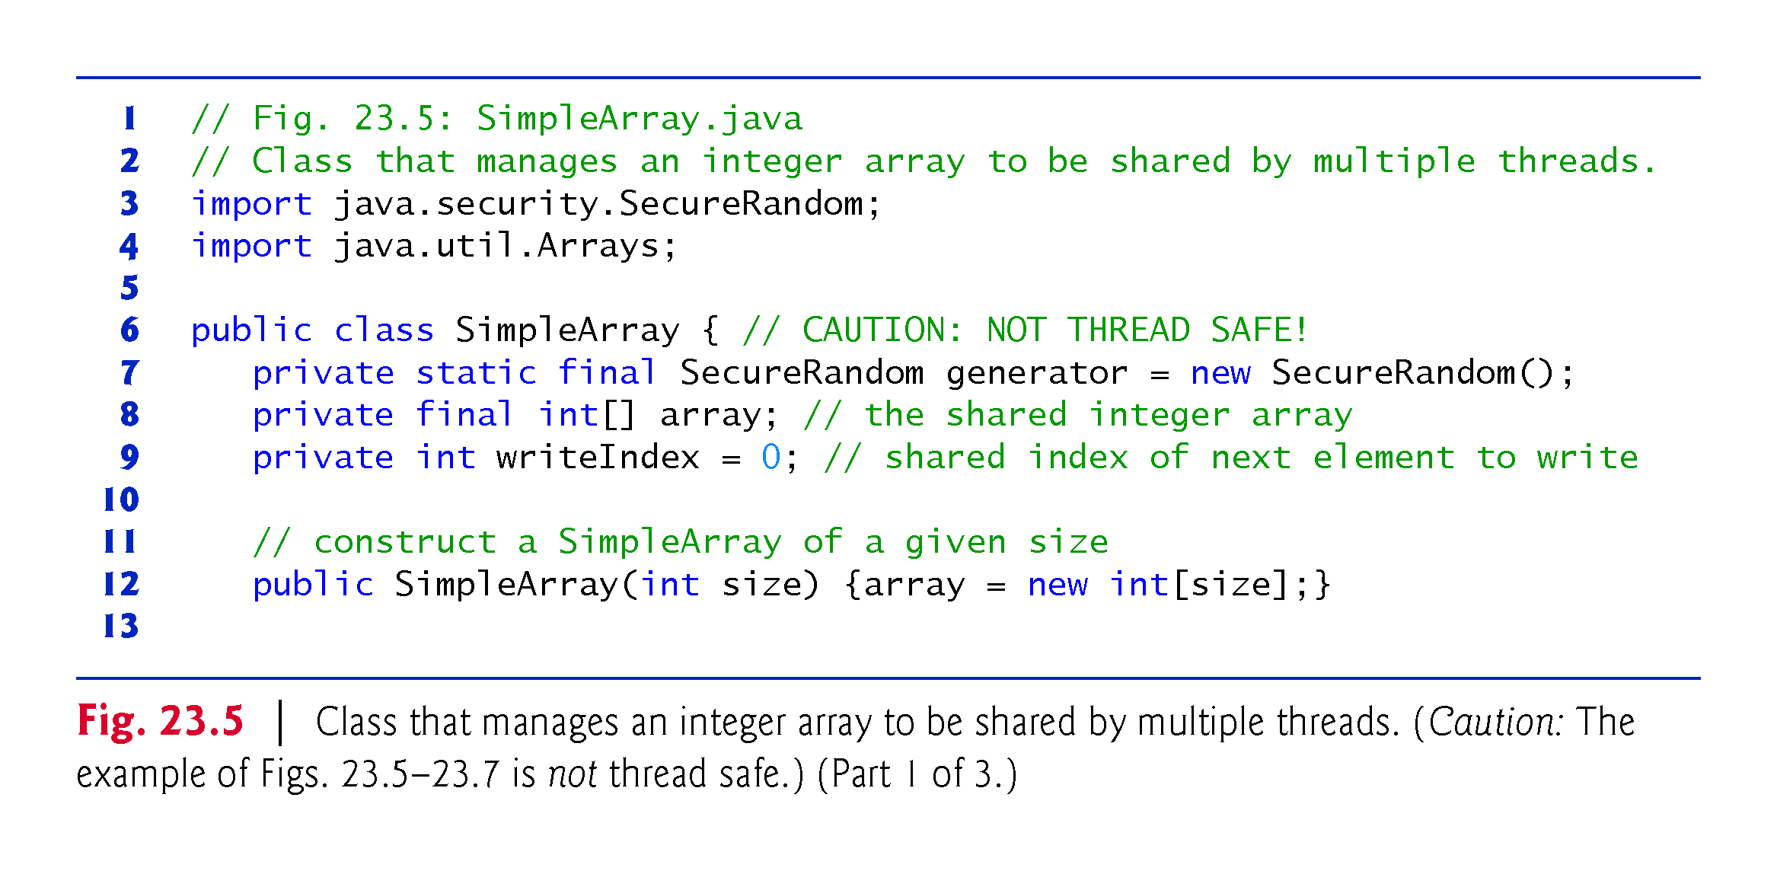

Slide 46
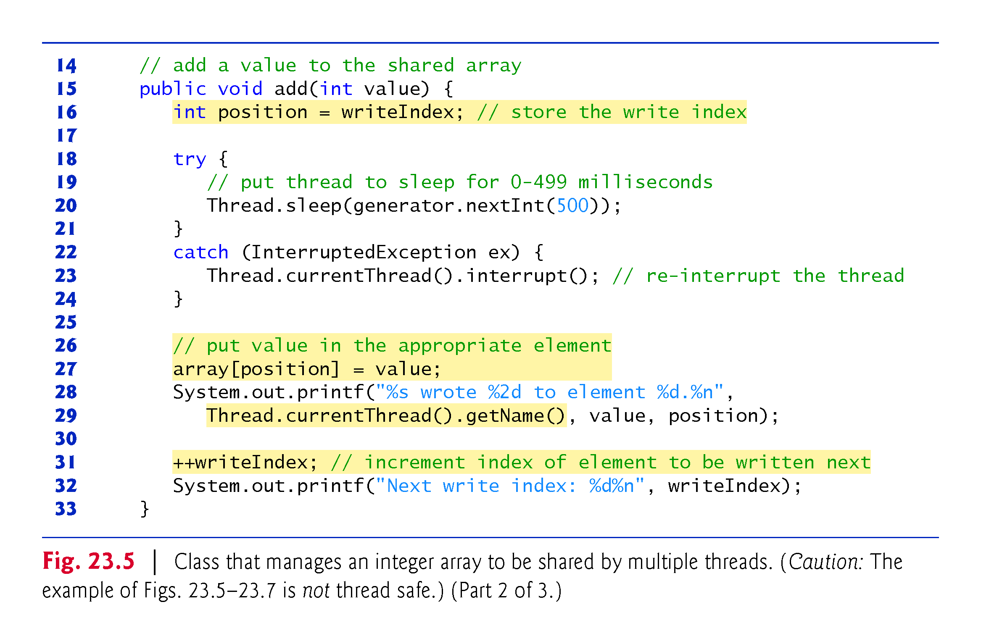

Slide 47
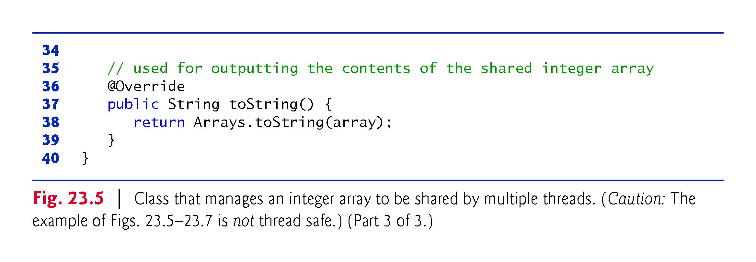

Slide 48
23.4.3 Unsynchronized Data Sharing (cont.)
Class ArrayWriter (Fig. 23.6) implements the interface Runnable to define a task for inserting values in a SimpleArray object.
The task completes after three consecutive integers beginning with startValue are inserted in the SimpleArray object.

Slide 49
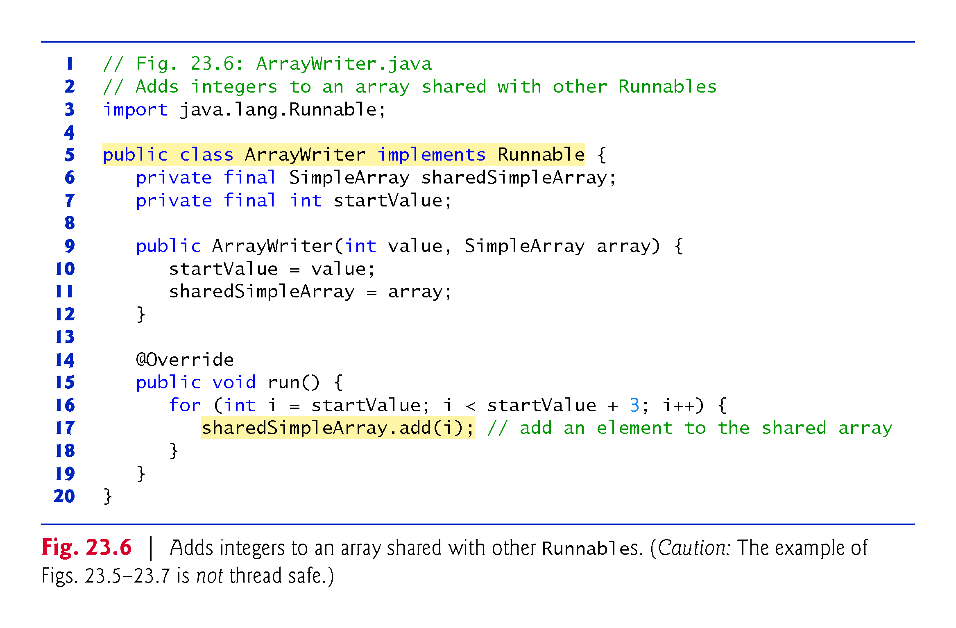

Slide 50
23.4.3 Unsynchronized Data Sharing (cont.)
Class SharedArrayTest (Fig. 23.7) executes two ArrayWriter tasks that add values to a single SimpleArray object.
ExecutorService’s shutDown method prevents additional tasks from starting and to enable the application to terminate when the currently executing tasks complete execution.
We’d like to output the SimpleArray object to show you the results after the threads complete their tasks.
So, we need the program to wait for the threads to complete before main outputs the SimpleArray object’s contents.
Interface ExecutorService provides the awaitTermination method for this purpose—returns control to its caller either when all tasks executing in the ExecutorService complete or when the specified timeout elapses.

Slide 51
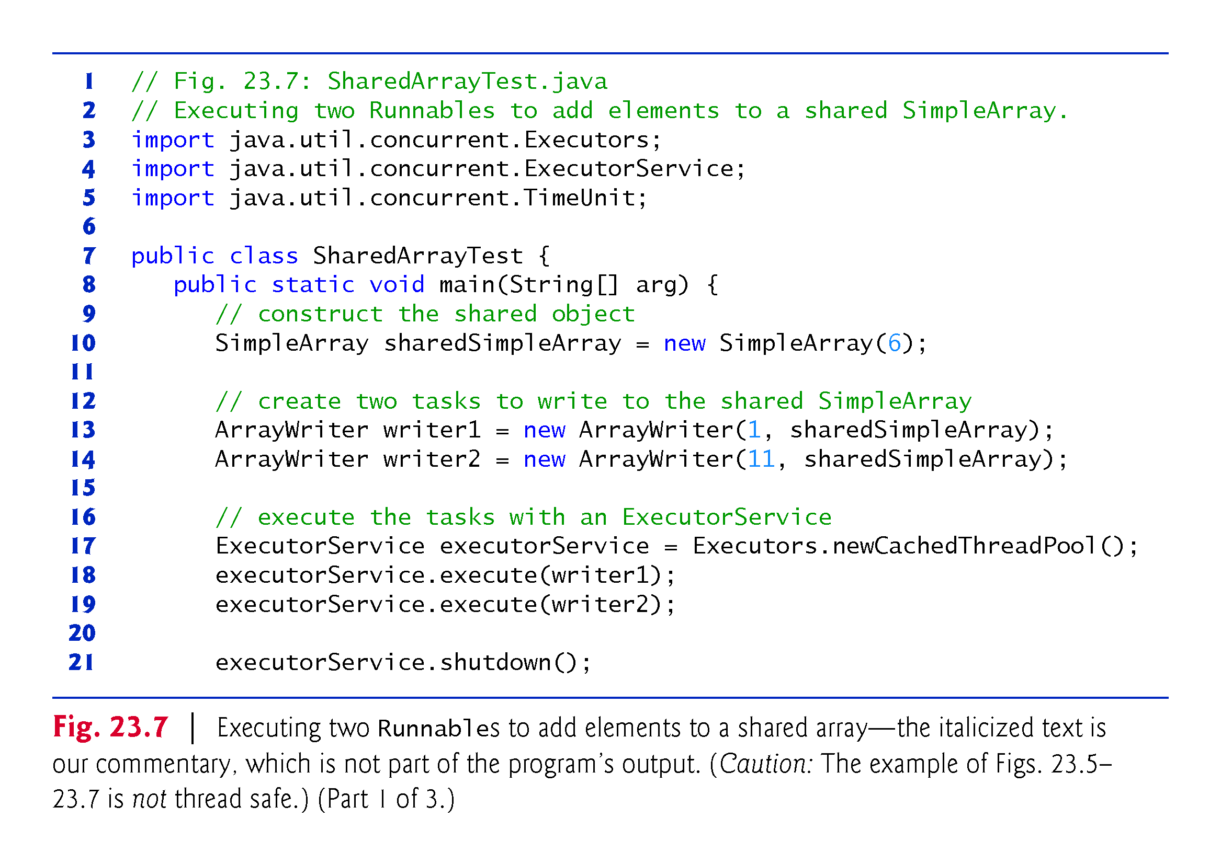

Slide 52
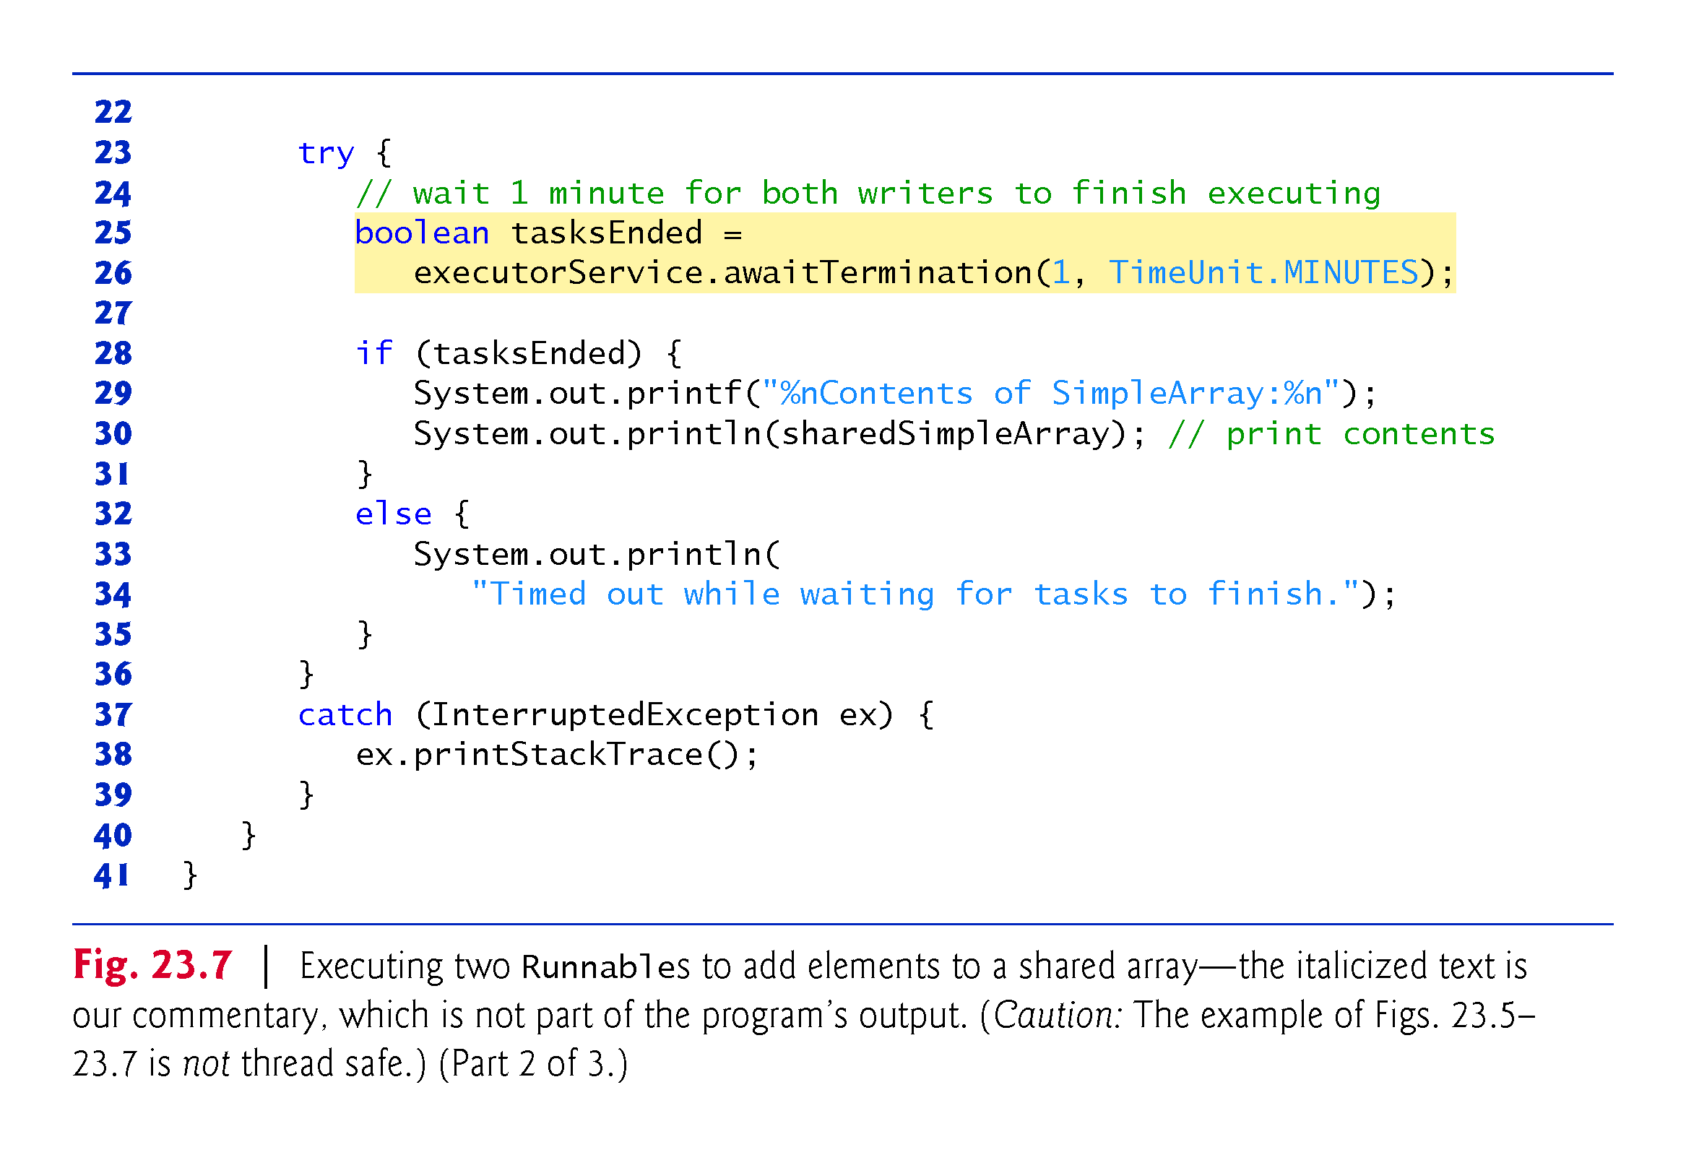

Slide 53
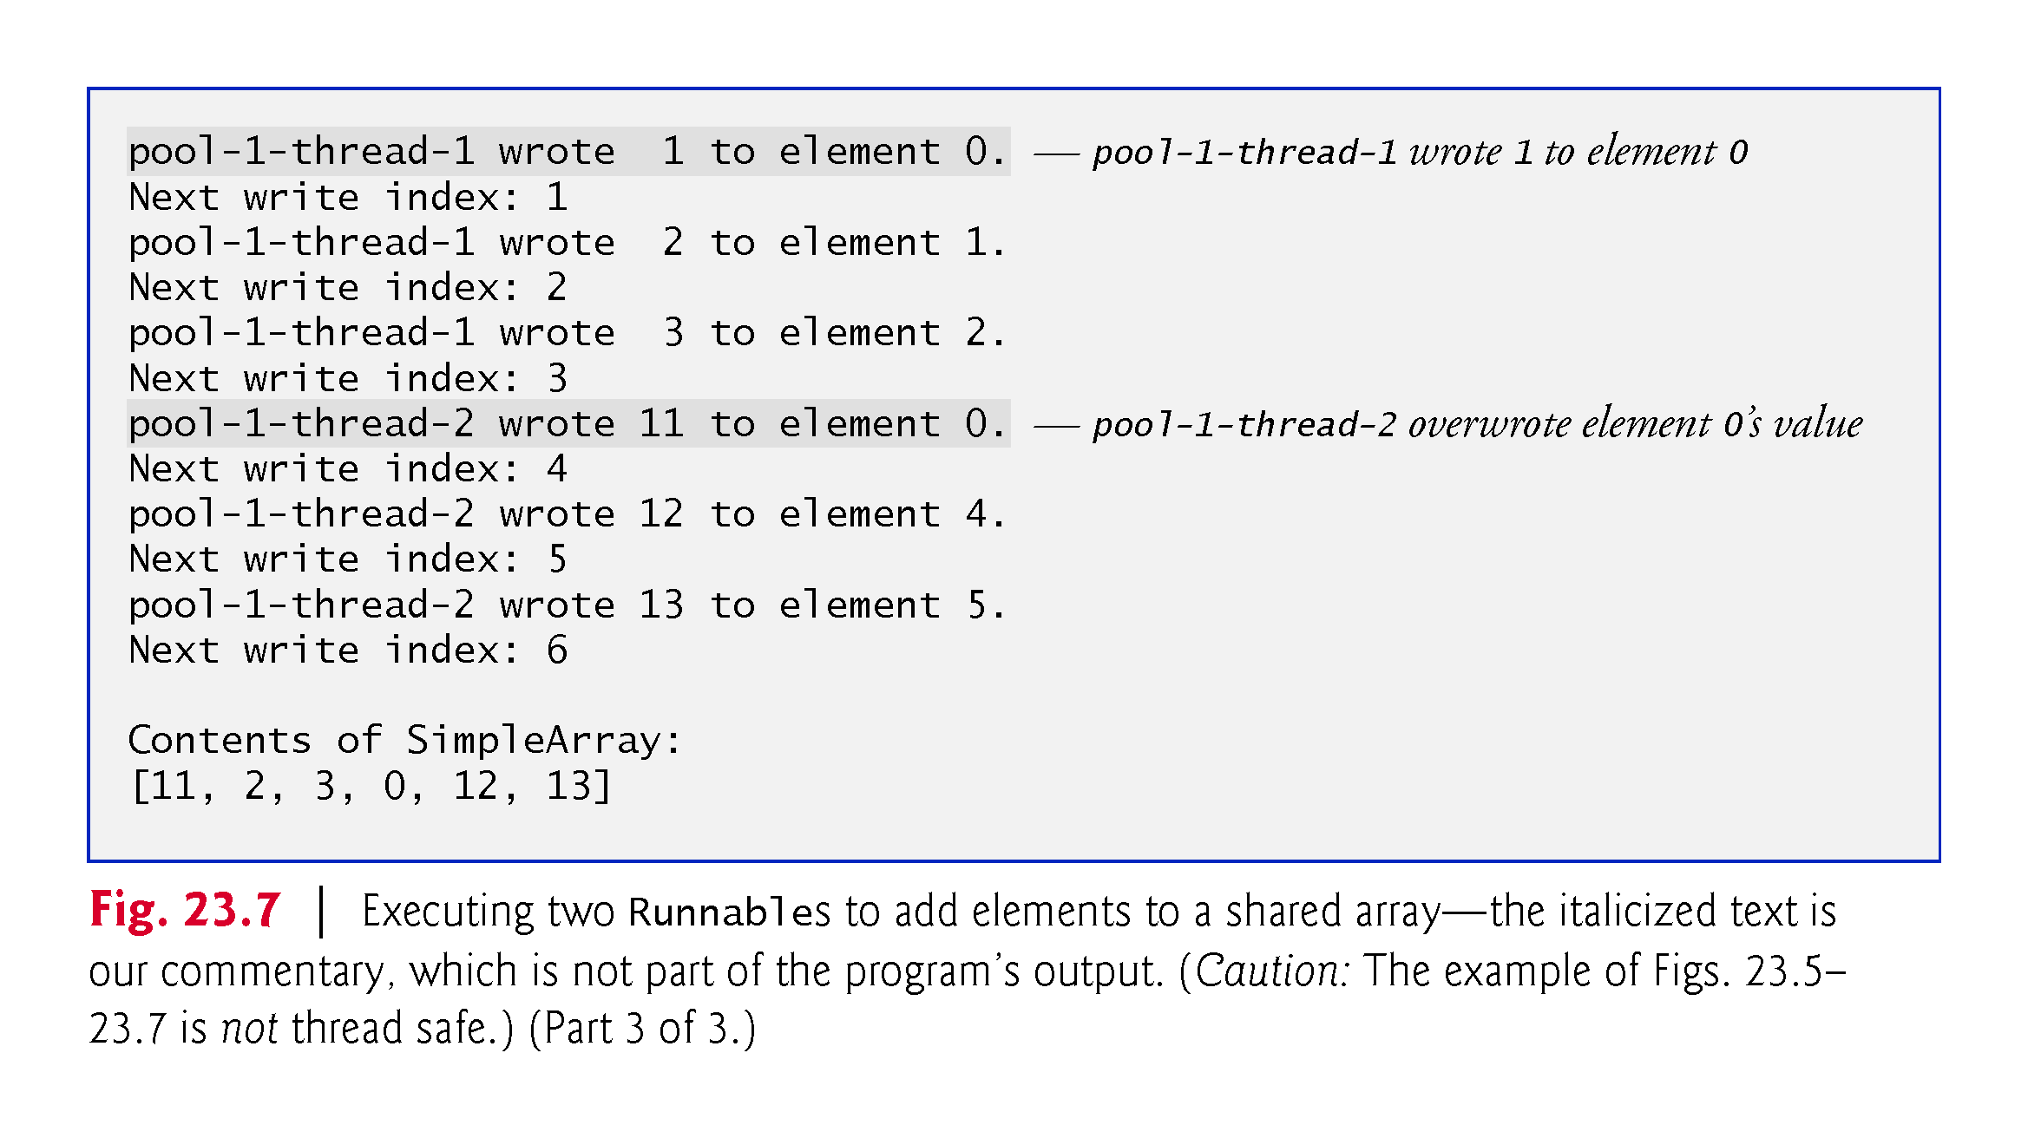

Slide 54
23.4.4 Synchronized Mutable Data Sharing—Making Operations Atomic
The output errors of Fig. 23.7 can be attributed to the fact that the shared object, SimpleArray, is not thread safe.
If one thread obtains the value of writeIndex, there is no guarantee that another thread cannot come along and increment writeIndex before the first thread has had a chance to place a value in the array.
If this happens, the first thread will be writing to the array based on a stale value of writeIndex—a value that is no longer valid.

Slide 55
23.4.4 Synchronized Mutable Data Sharing—Making Operations Atomic (cont.)
An atomic operation cannot be divided into smaller suboperations.
Can simulate atomicity by ensuring that only one thread carries out the three operations at a time.
Atomicity can be achieved using the synchronized keyword.

Slide 56
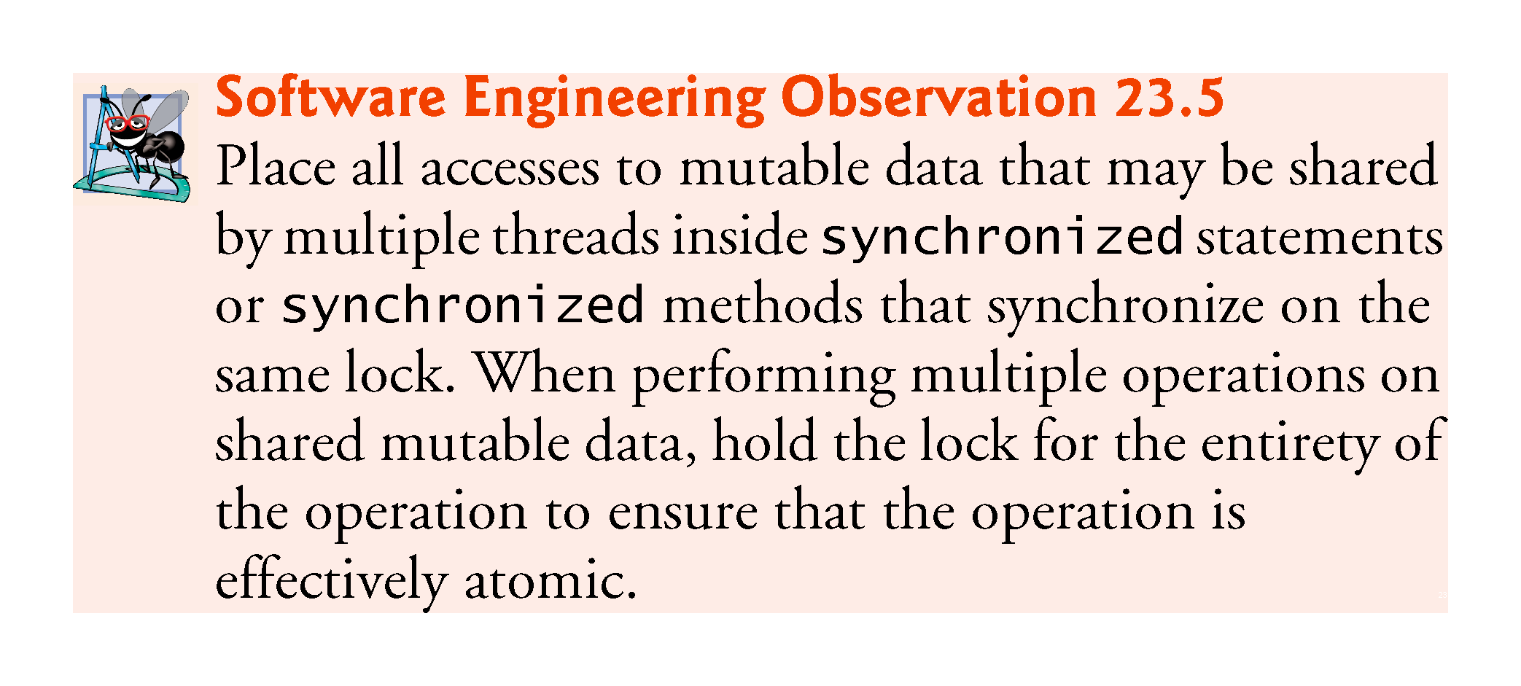

Slide 57
23.4.4 Synchronized Data Sharing—Making Operations Atomic (cont.)
Figure 23.8 displays class SimpleArray with the proper synchronization.
Identical to the SimpleArray class of Fig. 23.5, except that add is now a synchronized method—only one thread at a time can execute this method.
We reuse classes ArrayWriter (Fig. 23.6) and SharedArrayTest (Fig. 23.7) from the previous example.
We output messages from synchronized blocks for demonstration purposes
I/O should not be performed in synchronized blocks, because it’s important to minimize the amount of time that an object is “locked.”
We call Thread method sleep to emphasize the unpredictability of thread scheduling.
Never call sleep while holding a lock in a real application.

Slide 58
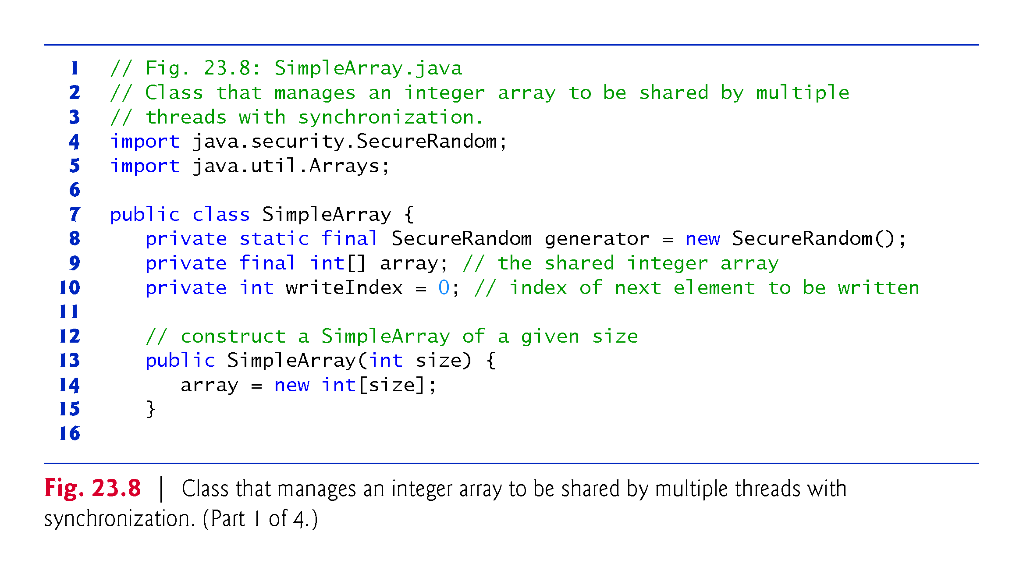

Slide 59
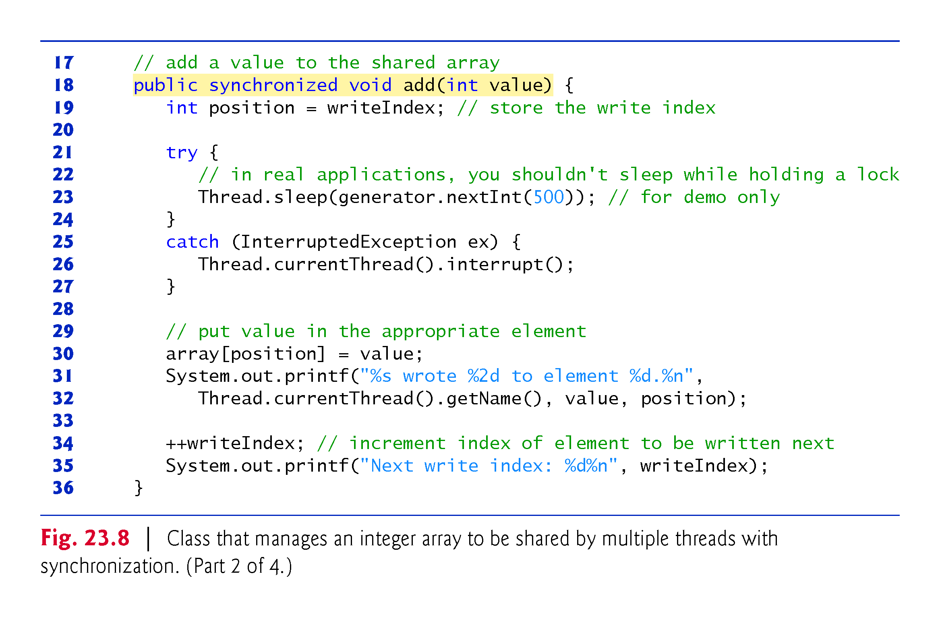

Slide 60
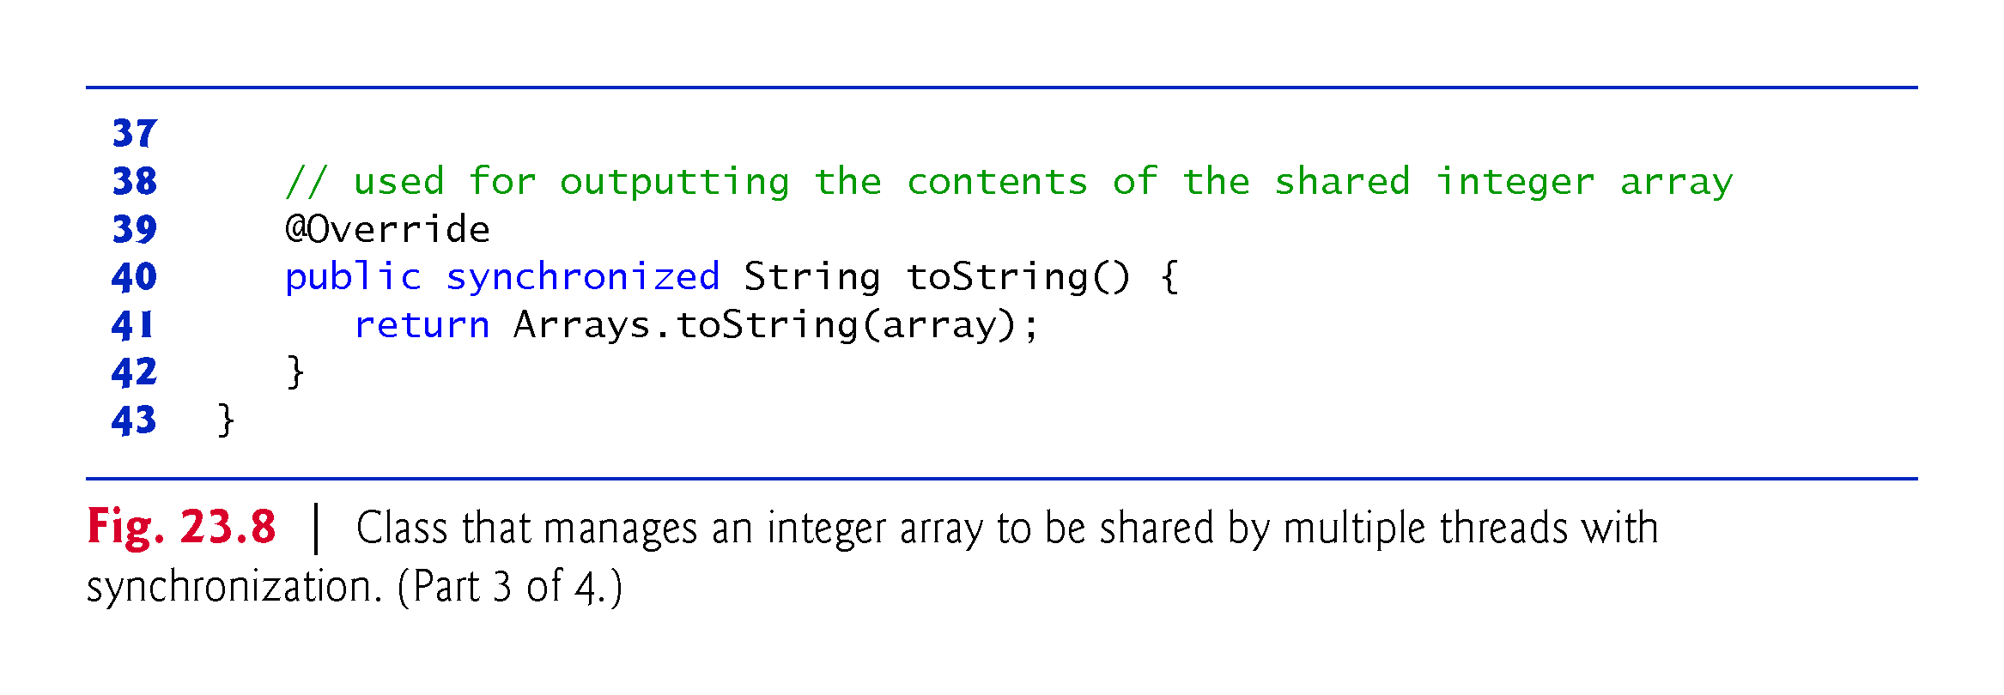

Slide 61
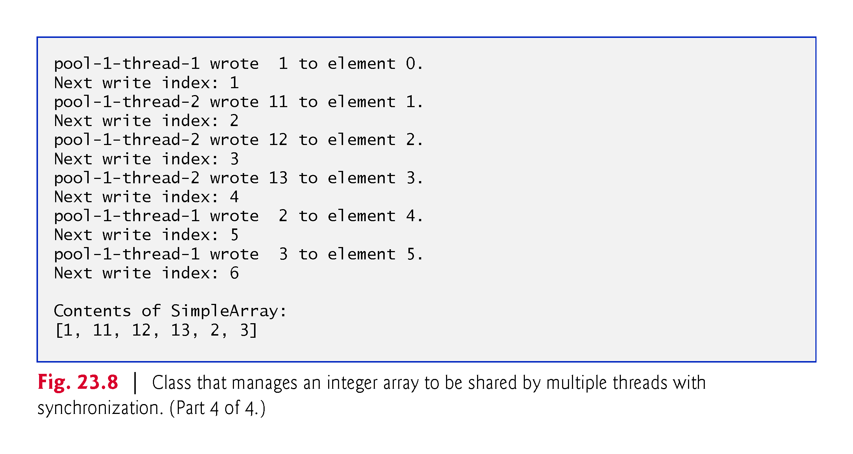

Slide 62
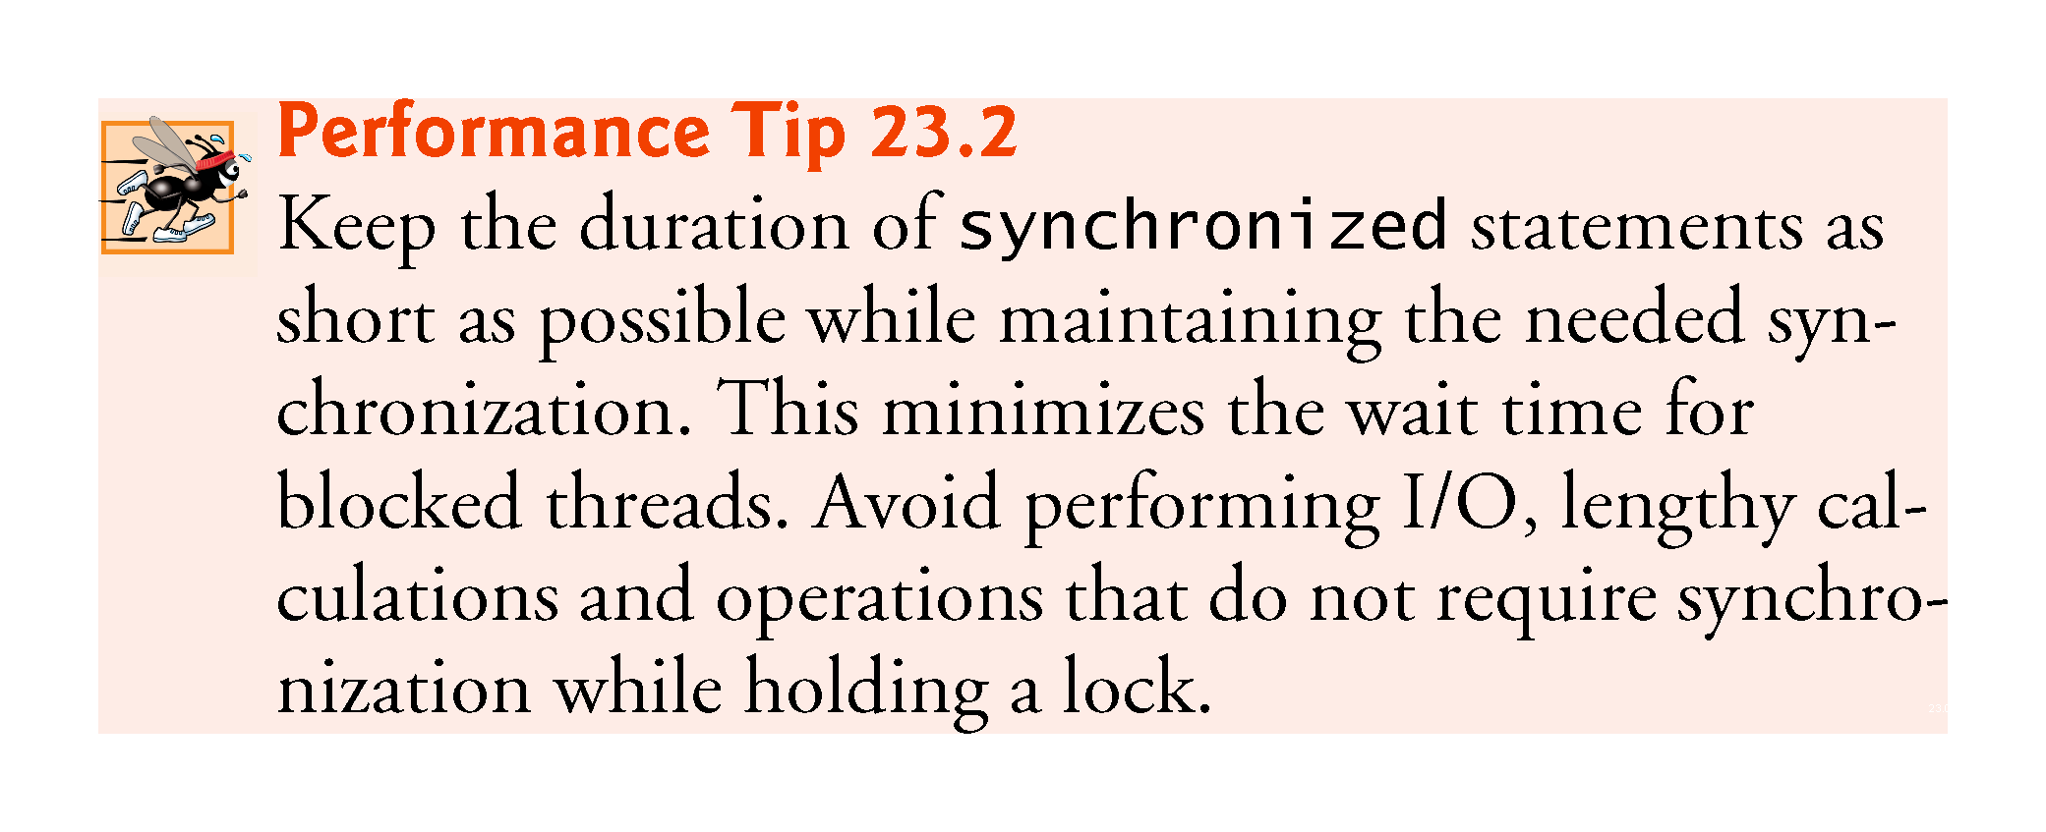

Slide 63
23.5 Producer/Consumer Relationship without Synchronization
In a producer/consumer relationship, the producer portion of an application generates data and stores it in a shared object, and the consumer portion of the application reads data from the shared object.
A producer thread generates data and places it in a shared object called a buffer.
A consumer thread reads data from the buffer.
This relationship requires synchronization to ensure that values are produced and consumed properly.
Operations on the buffer data shared by a producer and consumer thread are also state dependent—the operations should proceed only if the buffer is in the correct state.
If the buffer is in a not-full state, the producer may produce; if the buffer is in a not-empty state, the consumer may consume.

Slide 64
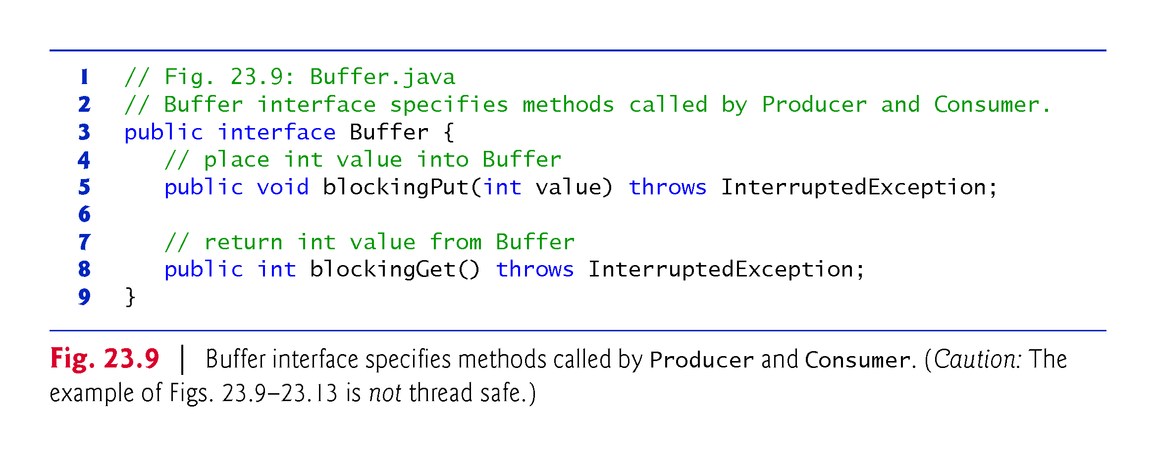

Slide 65
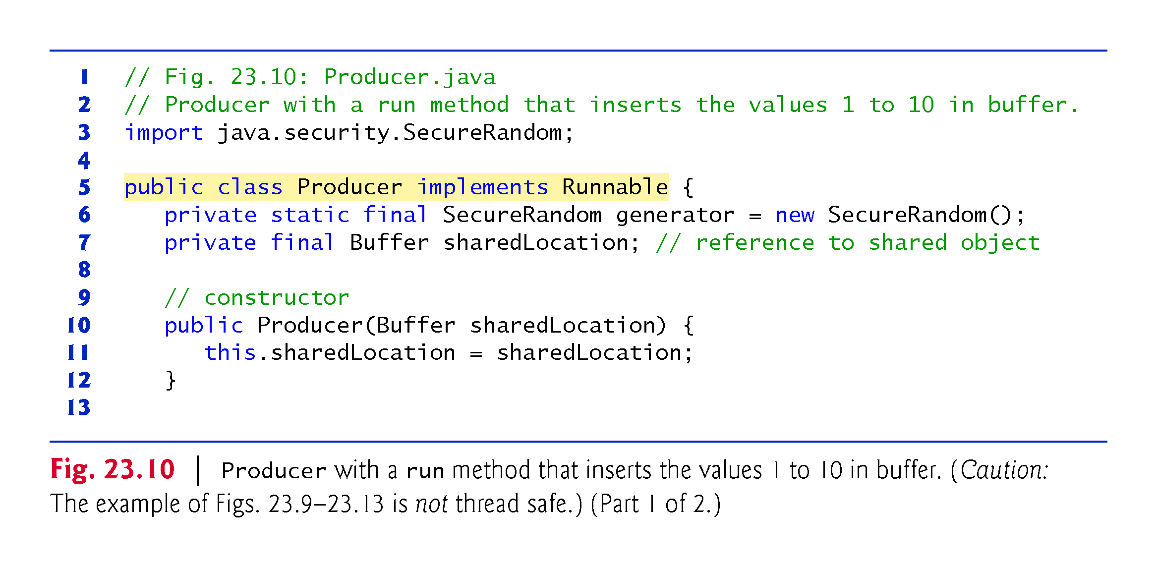

Slide 66
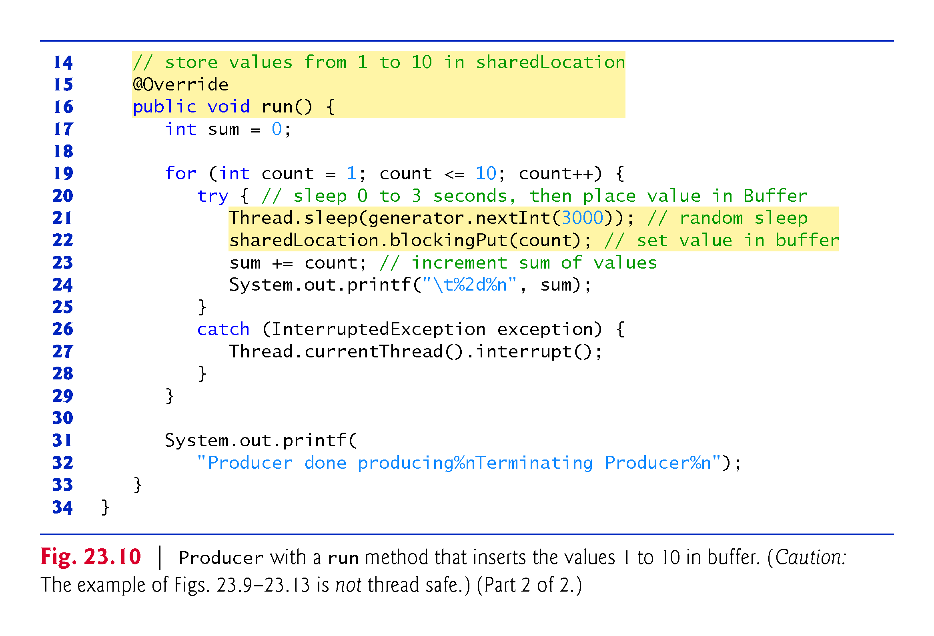

Slide 67
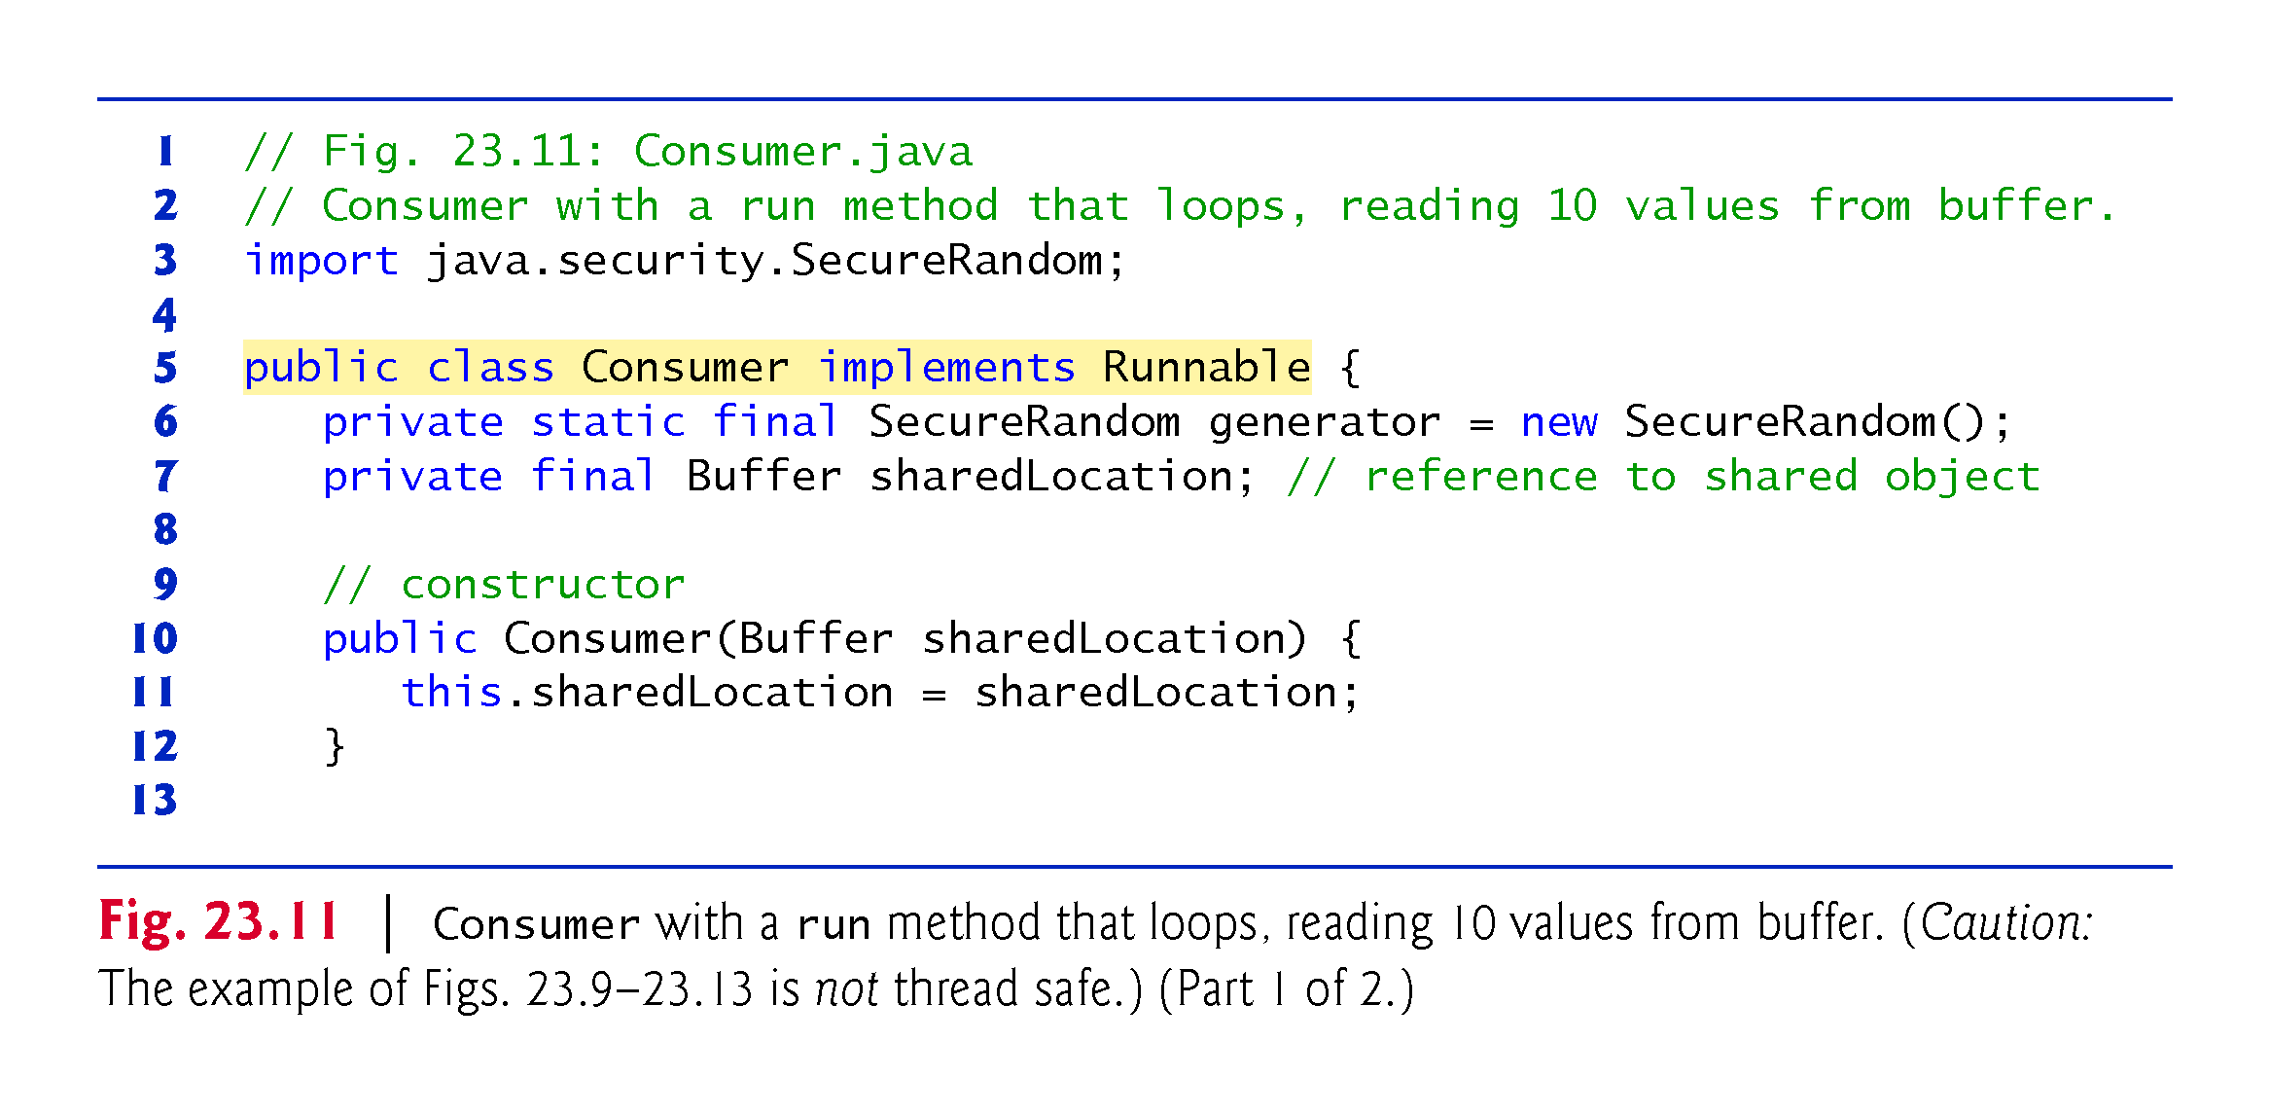

Slide 68
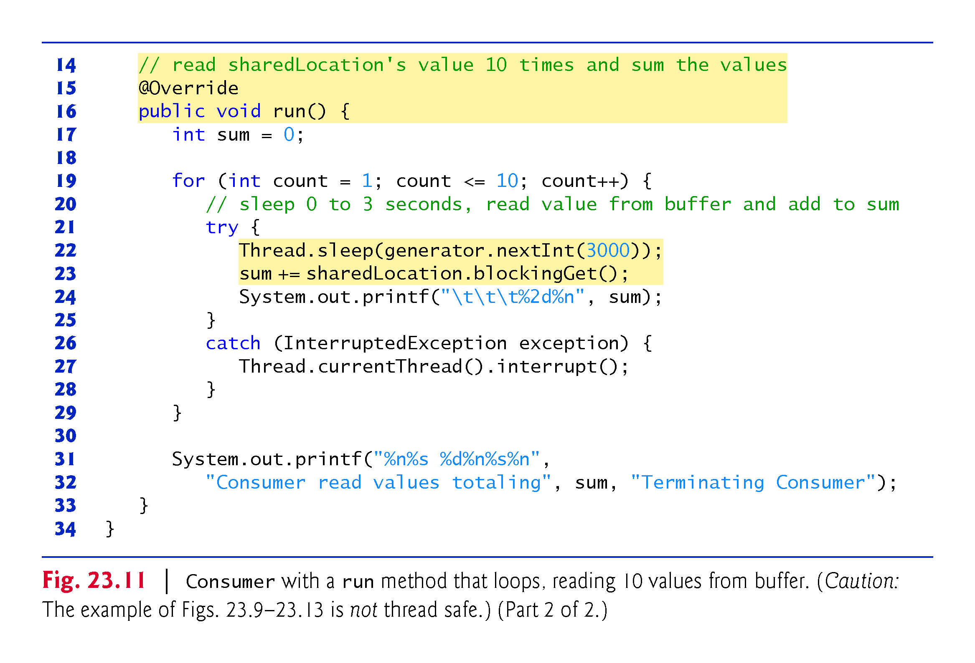

Slide 69
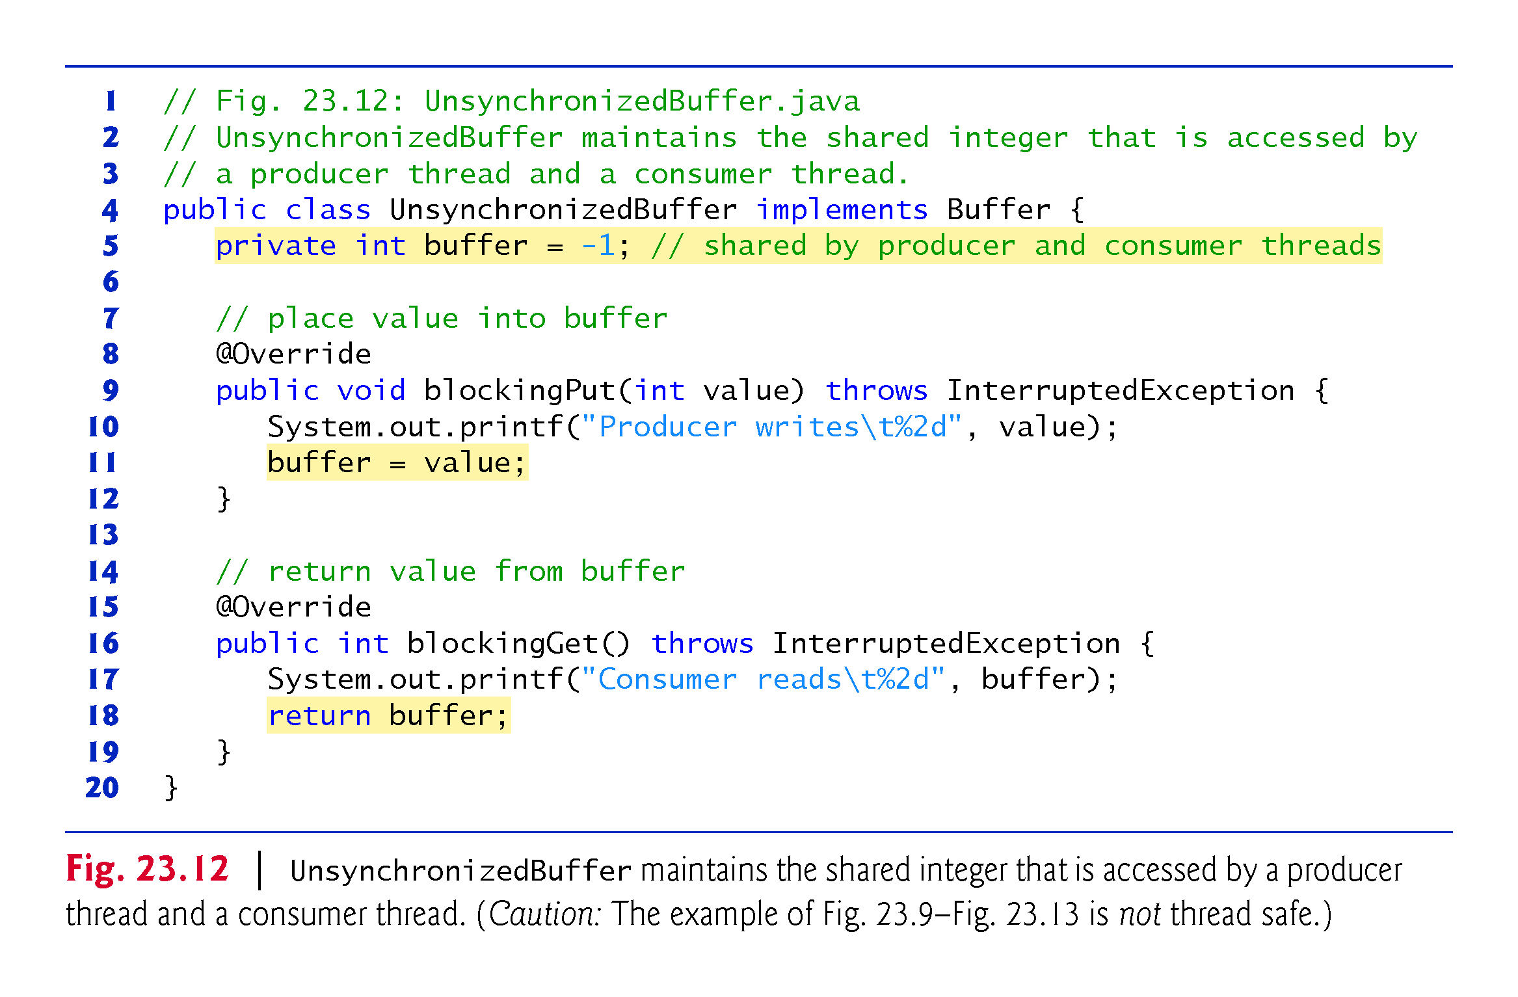

Slide 70
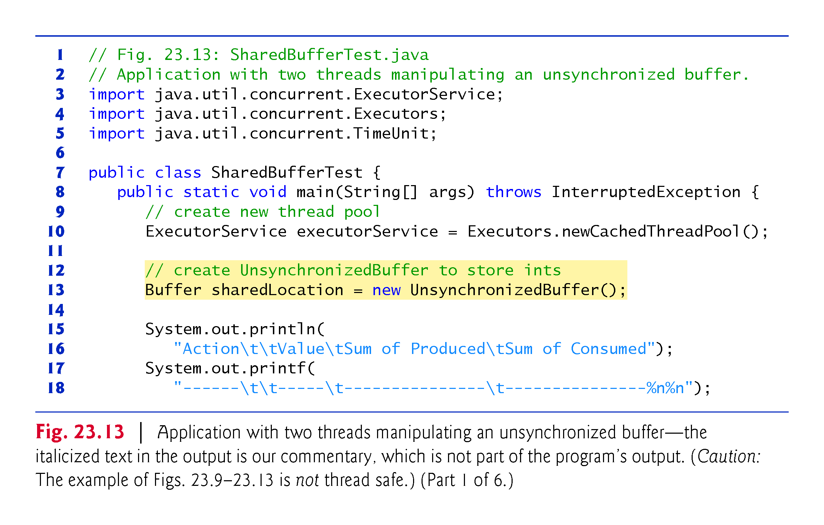

Slide 71
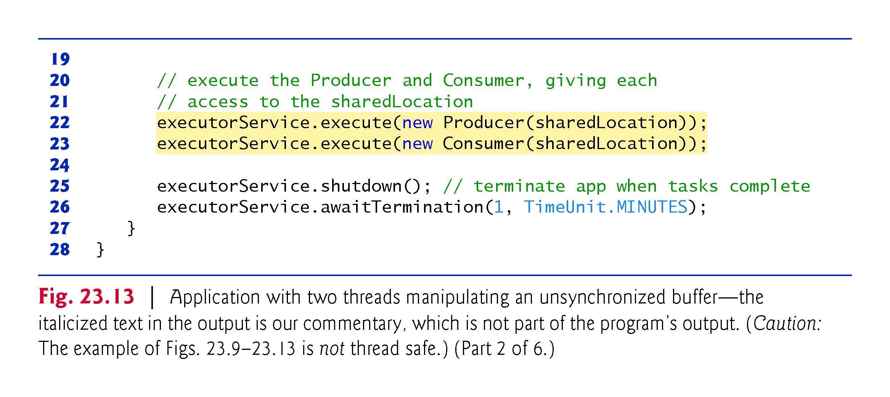

Slide 72
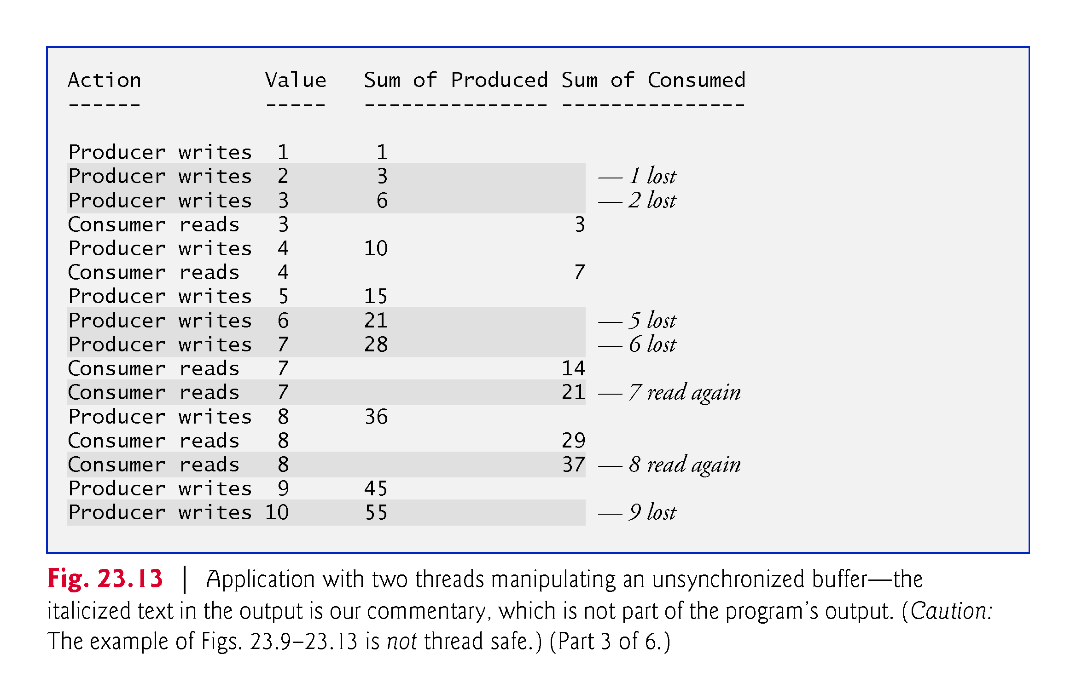

Slide 73
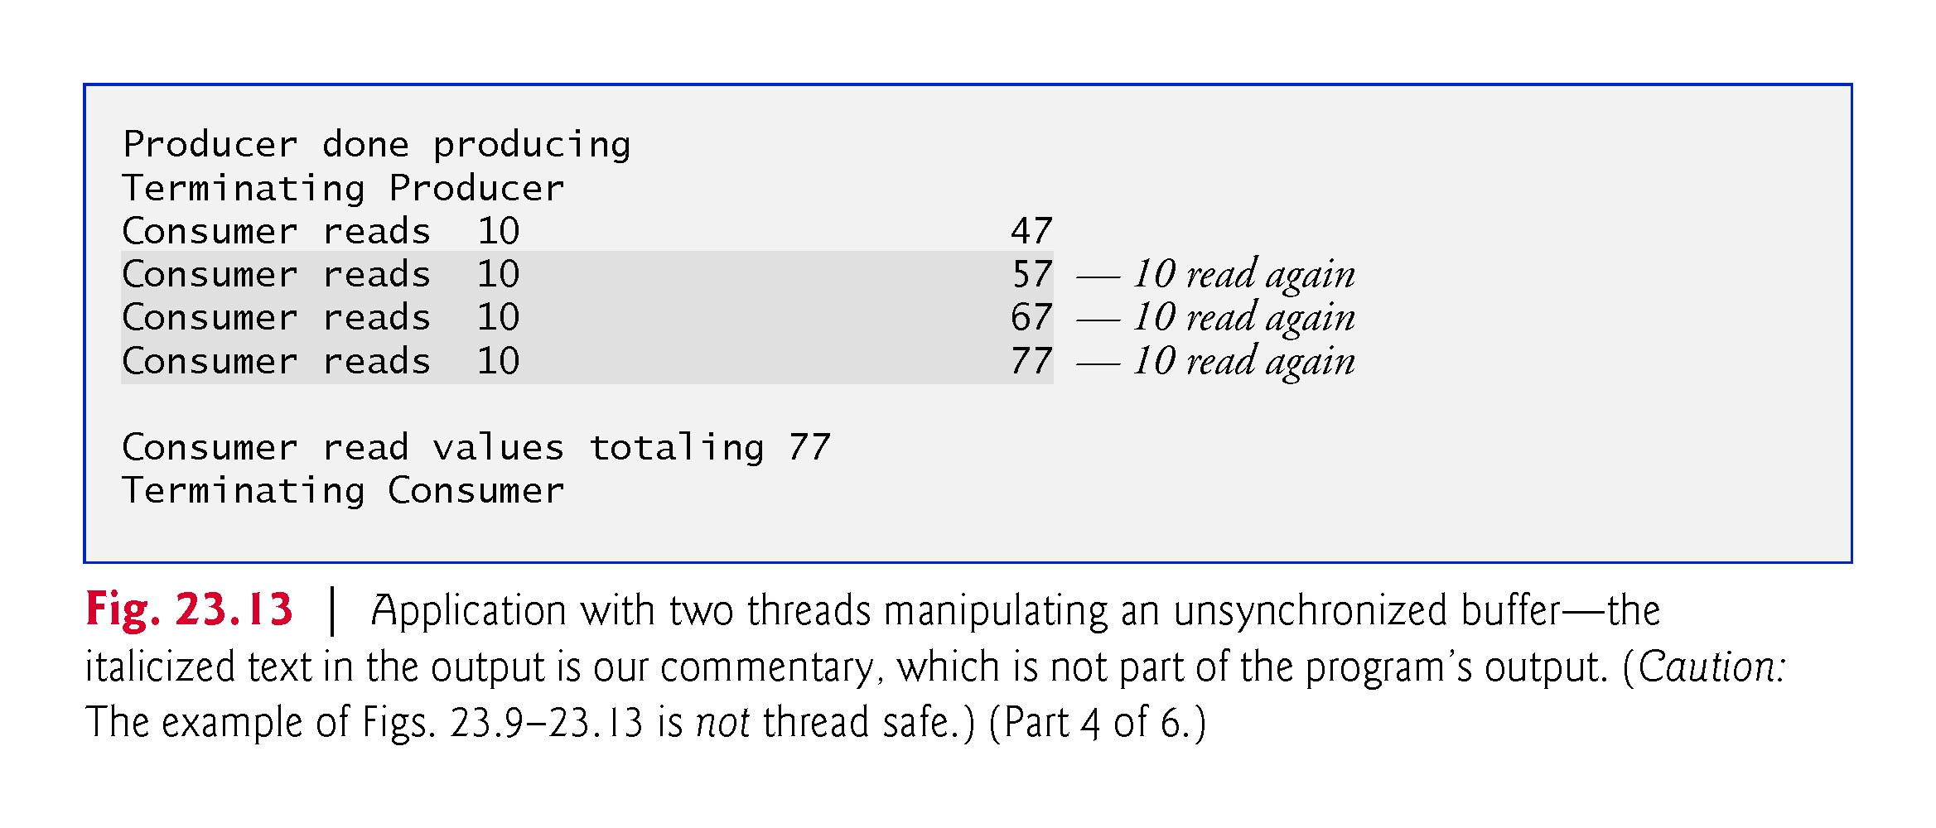

Slide 74
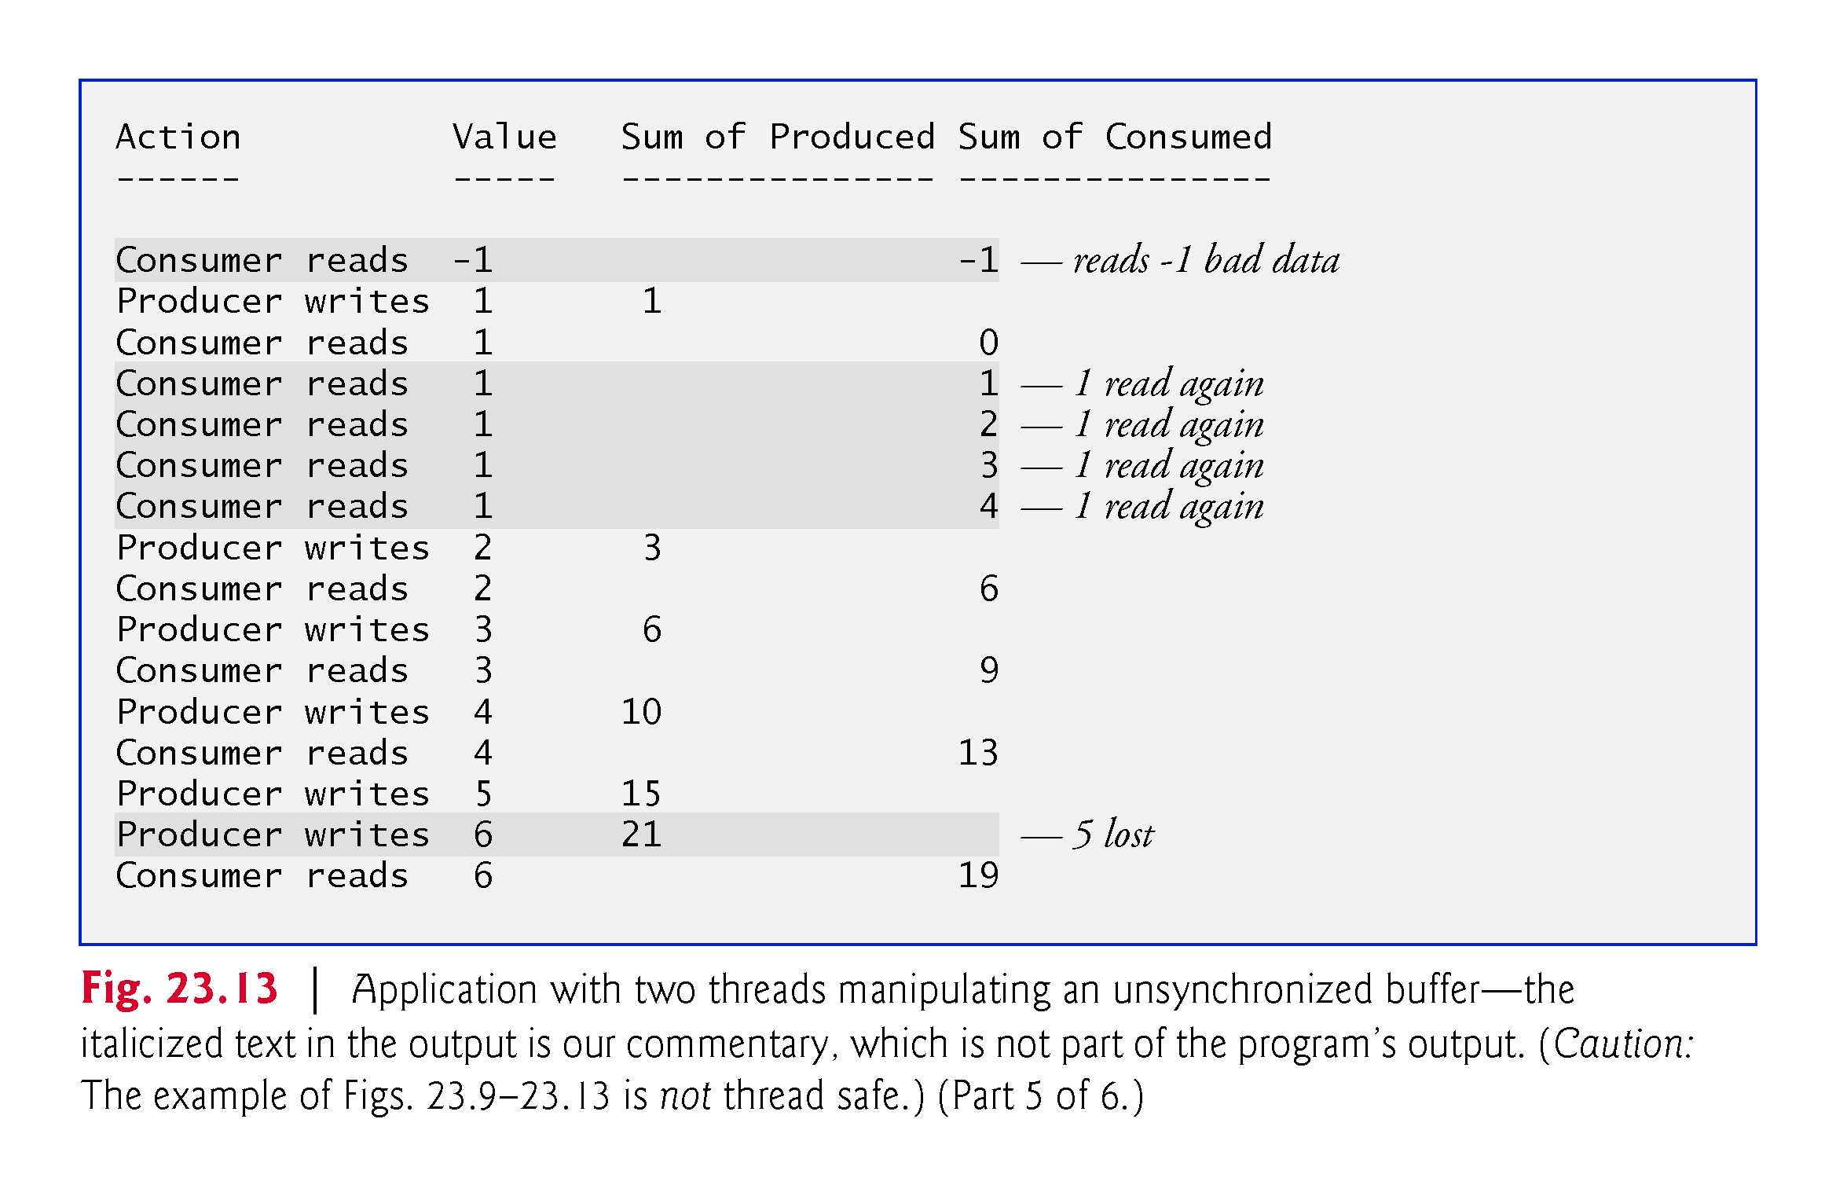

Slide 75
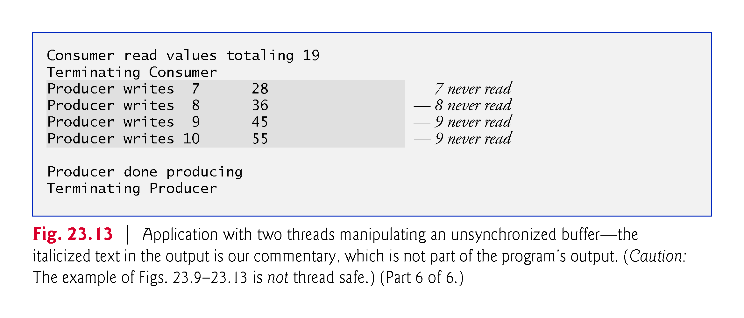

Slide 76
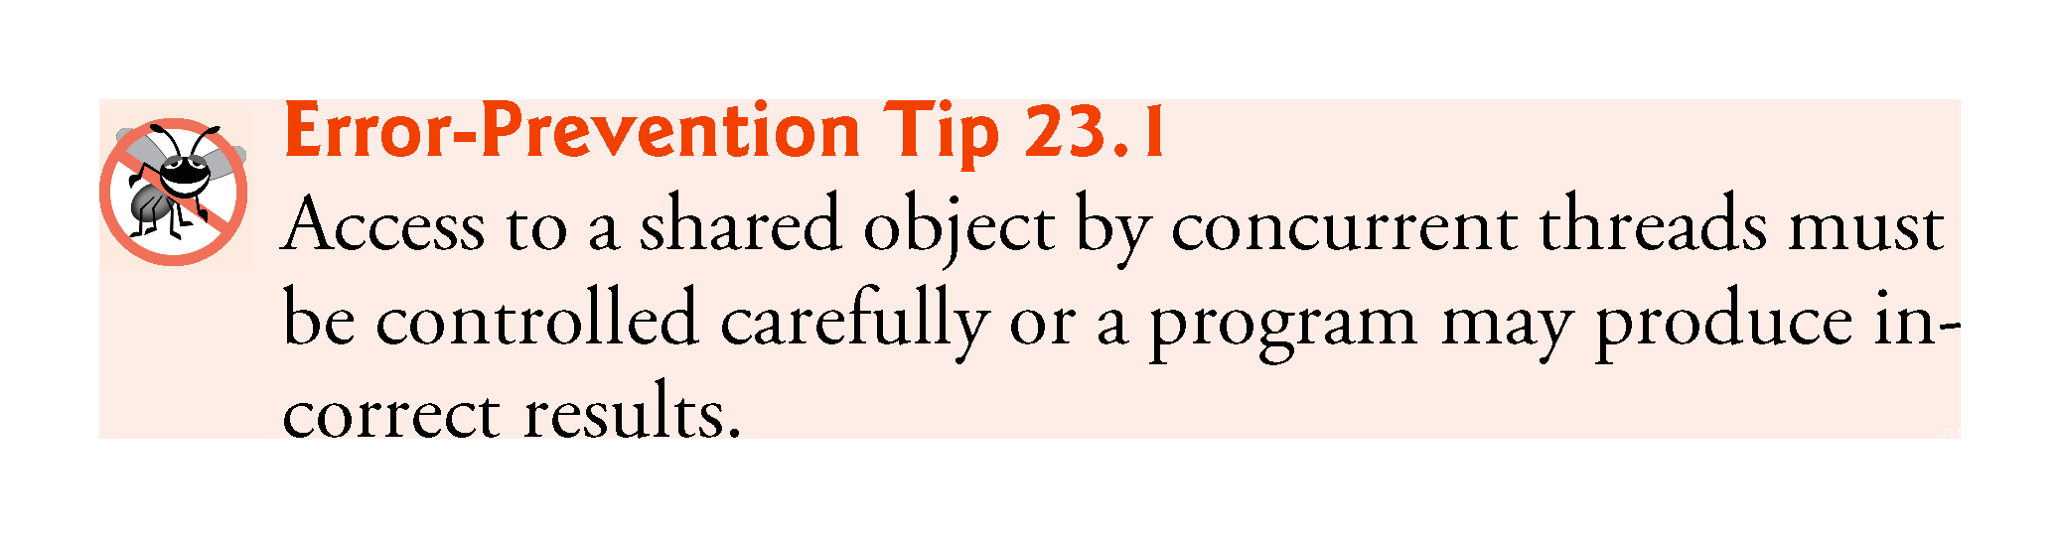

Slide 77
23.6 Producer/Consumer Relationship: ArrayBlockingQueue
The best way to synchronize producer and consumer threads is to use classes from Java’s java.util.concurrent package that encapsulate the synchronization for you.
Java includes the class ArrayBlockingQueue- (from package java.util.concurrent)—a fully implemented, thread-safe buffer class that implements interface BlockingQueue.
Declares methods put and take, the blocking equivalents of Queue methods offer and poll, respectively.
Method put places an element at the end of the BlockingQueue, waiting if the queue is full.
Method take removes an element from the head of the BlockingQueue, waiting if the queue is empty.

Slide 78
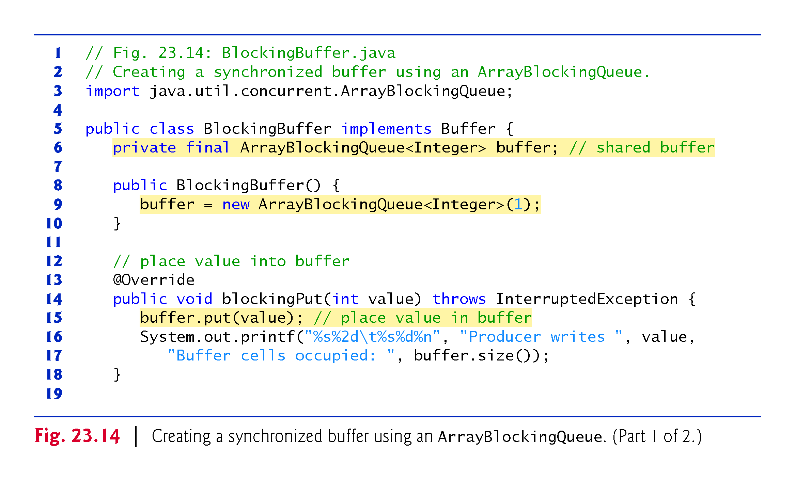

Slide 79
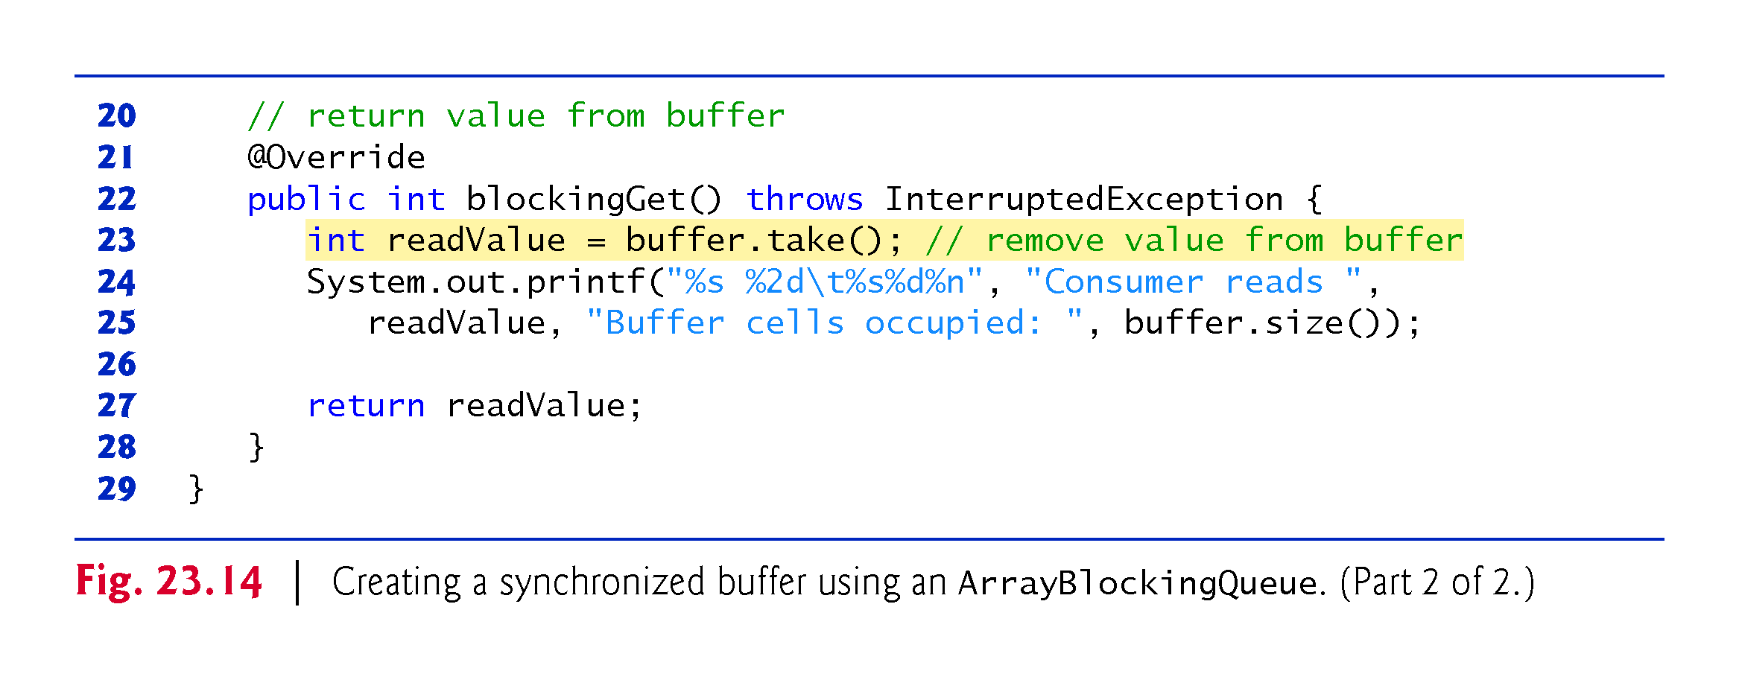

Slide 80
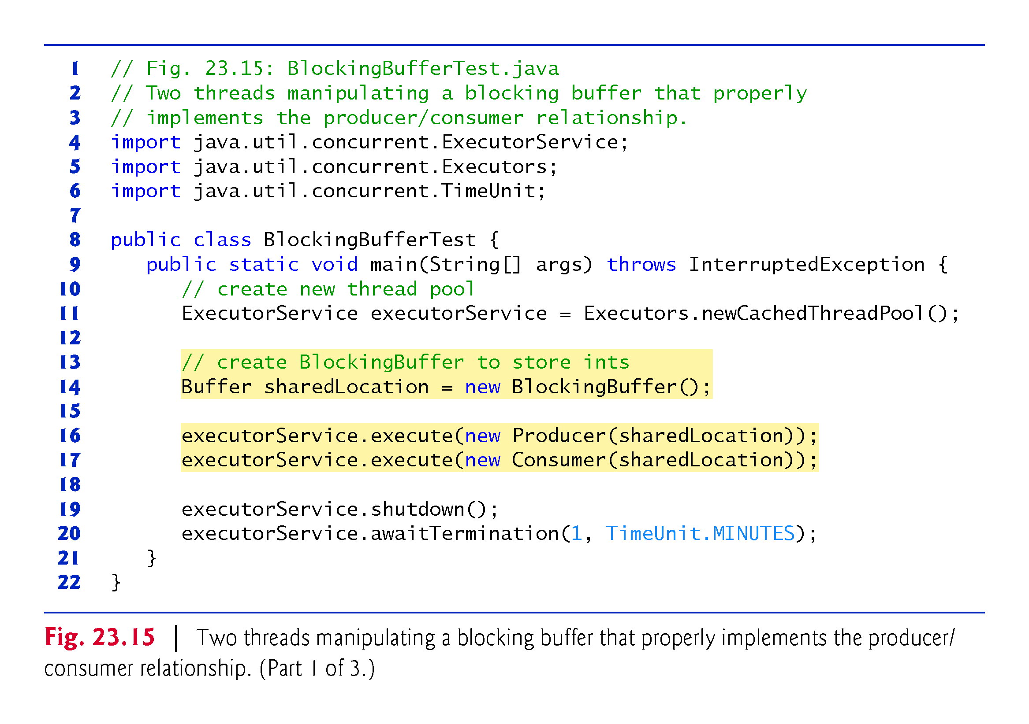

Slide 81
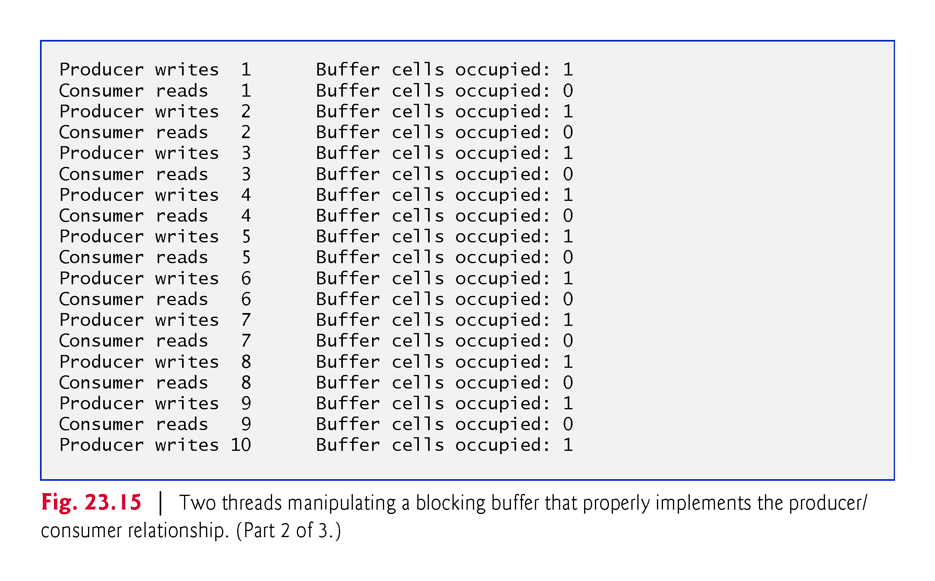

Slide 82


Slide 83
23.7 (Advanced) Producer/Consumer Relationship with synchronized, wait, notify and notifyAll
For educational purposes, we now explain how you can implement a shared buffer yourself using the synchronized keyword and methods of class Object.
After identifying the shared mutable data and the synchronization policy (i.e., associating the data with a lock that guards it), the next step in synchronizing access to the buffer is to implement methods blockingGet and blockingPut as synchronized methods.
This requires that a thread obtain the monitor lock on the Buffer object before attempting to access the buffer data.

Slide 84
23.7 (Advanced) Producer/Consumer Relationship with synchronized, wait, notify and notifyAll (cont.)
Object methods wait, notify and notifyAll can be used with conditions to make threads wait when they cannot perform their tasks.
Calling Object method wait on a synchronized object releases its monitor lock, and places the calling thread in the waiting state.
Call Object method notify on a synchronized object allows a waiting thread to transition to the runnable state again.
If a thread calls notifyAll on the synchronized object, then all the threads waiting for the monitor lock become eligible to reacquire the lock.

Slide 85


Slide 86


Slide 87


Slide 88


Slide 89


Slide 90


Slide 91
23.7 (Advanced) Producer/Consumer Relationship with synchronized, wait, notify and notifyAll (cont.)
The synchronization is handled in class SynchronizedBuffer’s blockingPut and blockingGet methods (Fig. 23.16), which implements interface Buffer
Thus, the Producer’s and Consumer’s run methods simply call the shared object’s synchronized blockingPut and blockingGet methods.

Slide 92


Slide 93


Slide 94


Slide 95


Slide 96


Slide 97


Slide 98


Slide 99
23.8 (Advanced) Producer/Consumer Relationship: Bounded Buffers
The program in Section 23.7 may not perform optimally.
If the two threads operate at different speeds, one them will spend more (or most) of its time waiting.
Even when we have threads that operate at the same relative speeds, those threads may occasionally become “out of sync” over a period of time, causing one of them to wait for the other.
To minimize the amount of waiting time for threads that share resources and operate at the same average speeds, we can implement a bounded buffer that provides a fixed number of buffer cells into which the Producer can place values, and from which the Consumer can retrieve those values.

Slide 100


Slide 101


Slide 102
23.8 (Advanced) Producer/Consumer Relationship: Bounded Buffers (cont.)
The simplest way to implement a bounded buffer is to use an ArrayBlockingQueue for the buffer so that all of the synchronization details are handled for you.
This can be done by reusing the example from Section 23.6 and simply passing the desired size for the bounded buffer into the ArrayBlockingQueue constructor.

Slide 103
23.8 (Advanced) Producer/Consumer Relationship: Bounded Buffers (cont.)
Implementing Your Own Bounded Buffer as a Circular Buffer
The program in Fig. 23.18 and Fig. 23.19 demonstrates a Producer and a Consumer accessing a bounded buffer with synchronization.
We implement the bounded buffer in class CircularBuffer (Fig. 23.18) as a circular buffer that writes into and reads from the array elements in order, beginning at the first cell and moving toward the last.
When a Producer or Consumer reaches the last element, it returns to the first and begins writing or reading, respectively, from there.

Slide 104


Slide 105


Slide 106


Slide 107


Slide 108


Slide 109


Slide 110


Slide 111


Slide 112


Slide 113


Slide 114


Slide 115


Slide 116


Slide 117
23.9 (Advanced) Producer/Consumer Relationship: The Lock and Condition Interfaces
In this section, we discuss the Lock and Condition interfaces.
These interfaces give you more precise control over thread synchronization, but are more complicated to use.
Any object can contain a reference to an object that implements the Lock interface (of package java.util.concurrent.locks).
A thread calls the Lock’s lock method to acquire the lock.
Once a Lock has been obtained by one thread, the Lock object will not allow another thread to obtain the Lock until the first thread releases the Lock (by calling the Lock’s unlock method).
If several threads are trying to call method lock on the same Lock object at the same time, only one of these threads can obtain the lock—all the others are placed in the waiting state for that lock.

Slide 118
23.9 (Advanced) Producer/Consumer Relationship: The Lock and Condition Interfaces (cont.)
When a thread calls method unlock, the lock on the object is released and a waiting thread attempting to lock the object proceeds.
Class ReentrantLock (of package java.util.concurrent.locks) is a basic implementation of the Lock interface.
The constructor for a ReentrantLock takes a boolean argument that specifies whether the lock has a fairness policy.
If the argument is true, the ReentrantLock’s fairness policy is “the longest-waiting thread will acquire the lock when it’s available.”

Slide 119


Slide 120


Slide 121


Slide 122
23.9 (Advanced) Producer/Consumer Relationship: The Lock and Condition Interfaces (cont.)
If a thread that owns a Lock determines that it cannot continue with its task until some condition is satisfied, the thread can wait on a condition object.
Allows you to explicitly declare the condition objects on which a thread may need to wait.
For example, in the producer/consumer relationship, producers can wait on one object and consumers can wait on another.
Not possible when using the synchronized keywords and an object’s built-in monitor lock.
Condition objects are associated with a specific Lock and are created by calling a Lock’s newCondition method, which returns an object that implements the Condition interface (of package java.util.concurrent.locks).

Slide 123
23.9 Producer/Consumer Relationship: The Lock and Condition Interfaces (cont.)
To wait on a condition object, the thread can call the Condition’s await method.
This immediately releases the associated Lock and places the thread in the waiting state for that Condition.
When a runnable thread completes a task and determines that the waiting thread can now continue, the runnable thread can call Condition method signal to allow a thread in that Condition’s waiting state to return to the runnable state.
If a thread calls Condition method signalAll, then all the threads waiting for that condition transition to the runnable state and become eligible to reacquire the Lock.

Slide 124


Slide 125


Slide 126


Slide 127
23.9 (Advanced) Producer/Consumer Relationship: The Lock and Condition Interfaces (cont.)
Locks allow you to interrupt waiting threads or to specify a time-out for waiting to acquire a lock, which is not possible using the synchronized keyword.
Also, a Lock is not constrained to be acquired and released in the same block of code.
Condition objects allow you to specify multiple conditions on which threads may wait.
With the synchronized keyword, there is no way to explicitly state the condition on which threads are waiting.

Slide 128


Slide 129
23.9 (Advanced) Producer/Consumer Relationship: The Lock and Condition Interfaces (cont.)
We create two Conditions using Lock method newCondition.
Condition canWrite contains a queue for a Producer thread waiting while the buffer is full.
If the buffer is full, the Producer calls method await on this Condition.
When the Consumer reads data from a full buffer, it calls method signal on this Condition.
Condition canRead contains a queue for a Consumer thread waiting while the buffer is empty (i.e., there is no data in the buffer for the Consumer to read).
If the buffer is empty, the Consumer calls method await on this Condition.
When the Producer writes to the empty buffer, it calls method signal on this Condition.

Slide 130


Slide 131


Slide 132


Slide 133


Slide 134


Slide 135


Slide 136


Slide 137


Slide 138


Slide 139


Slide 140


Slide 141


Slide 142
23.10 Concurrent Collections
The collections from the java.util.concurrent package are specifically designed and optimized for sharing collections among multiple threads.
Fig. 23.22 lists the many concurrent collections in package java.util.concurrent .
For more Java SE 7 information, visit
http://docs.oracle.com/javase/7/docs/api/java/util/concurrent/package-summary.html
For Java SE 8 information, visit
http://download.java.net/jdk8/docs/api/java/util/concurrent/package-summary.html

Slide 143


Slide 144


Slide 145


Slide 146


Slide 147


Slide 148
23.11 Multithreading in JavaFX
All JavaFX applications have a single thread, called the JavaFX application thread, to handle interactions with the application’s controls
Typical interactions include rendering controls or processing user actions such as mouse clicks
All tasks that require interaction with an application’s GUI are placed in an event queue and are executed sequentially by the JavaFX- application thread

Slide 149
23.11 Multithreading in JavaFX (cont.)
JavaFX’s scene graph is not thread safe—its nodes cannot be manipulated by multiple threads without the risk of incorrect results that might corrupt the scene graph
Thread safety in JavaFX applications is achieved by ensuring that programs manipulate the scene graph from only the JavaFX application thread
This technique is called thread confinement
Allowing just one thread to access non-thread-safe objects eliminates the possibility of corruption due to multiple threads accessing these objects concurrently

Slide 150
23.11 Multithreading in JavaFX (cont.)
It’s acceptable to perform brief tasks on the JavaFX application thread in sequence with GUI component manipulations
If an application must perform a lengthy task in response to a user interaction, the JavaFX application thread cannot render controls or respond to events while the thread is tied up in that task
This causes the GUI to become unresponsive
It’s preferable to handle long-running tasks in separate threads, freeing the JavaFX application thread to continue managing other GUI interactions

Slide 151
23.11 Multithreading in JavaFX (cont.)
Platform Method runLater
JavaFX provides multiple mechanisms for updating the GUI from other threads
One is to call the static method runLater of class Platform (package javafx.application)
This method receives a Runnable and schedules it on the JavaFX application thread for execution at some point in the future
Such Runnables should perform only small updates, so the GUI remains responsive

Slide 152
23.11 Multithreading in JavaFX (cont.)
Class Task and Interface Worker
Long-running or compute-intensive tasks should be performed on separate worker threads, not the JavaFX application thread
Package javafx.concurrent provides interface Worker and classes Task and ScheduledService for this purpose
A Worker is a task that should execute using one or more separate threads.

Slide 153
23.11 Multithreading in JavaFX (cont.)
Class Task and Interface Worker
A Task is a Worker that enables you to perform a task in a worker thread and update the GUI from the JavaFX application thread based on the task’s results
Task implements Runnable, so a Task object can be scheduled to execute in a separate thread
Class Task also provides methods that are guaranteed to update its properties in the JavaFX application thread
Once a Task completes, it cannot be restarted
A ScheduledService is a Worker that creates and manages a Task
Can be reset and restarted
Can be configured to automatically restart both after successful completion and if it fails due to an exception.

Slide 154
23.11.1 Performing Computations in a Worker Thread: Fibonacci Numbers
Next example: User enters a number n and the program gets the nth Fibonacci number, which we calculate using the recursive algorithm discussed in Section 18.5
Since the algorithm is time consuming for large values, we use a Task object to perform the recursive calculation in a worker thread
The GUI also provides a separate set of components that displays the next Fibonacci number in the sequence with each click of a Button
This set of components performs its short computation directly in the event dispatch thread

Slide 155
23.11.1 Performing Computations in a Worker Thread: Fibonacci Numbers (cont.)
Creating a Task
Class FibonacciTask (Fig. 23.23) extends Task<Long> to perform the recursive Fibonacci calculation in a worker thread
The instance variable n represents the Fibonacci number to calculate.
Overridden Task method call computes the nth Fibonacci number and returns the result
The Task’s type parameter Long determines call’s return type
Inherited Task method updateMessage updates the Task’s message property in the JavaFX application thread
In Fig. 23.25, we'll bind JavaFX controls to FibonacciTask’s message property to display messages while the task is executing

Slide 156


Slide 157


Slide 158
23.11.1 Performing Computations in a Worker Thread: Fibonacci Numbers (cont.)
When the worker thread enters the running state, FibonacciTask’s call method begins executing
First, updateMessage updates the FibonacciTask’s message property, indicating that the task is calculating
When fibonacci returns, we update FibonacciTask’s message property again to indicate that the calculation completed, then return the result to the JavaFX application thread

Slide 159
23.11.1 Performing Computations in a Worker Thread: Fibonacci Numbers (cont.)
FibonacciNumbers GUI
Figure 23.24 shows the app’s GUI (defined in FibonacciNumbers.fxml) labeled with its fx:ids.
Event handlers
goButtonPressed is called when the Go Button is pressed—this launches the worker thread to calculate a Fibonacci number recursively
nextNumberButtonPressed is called when the Next Number Button is pressed—this calculates the next Fibonacci number in the sequence

Slide 160


Slide 161
23.11.1 Performing Computations in a Worker Thread: Fibonacci Numbers (cont.)
Class FibonacciNumbersController
Class FibonacciNumbersController (Fig. 23.25) displays a window containing two sets of controls:
The With FibonacciTask TitledPane provides controls that enable the user to enter a Fibonacci number to calculate and launch a FibonacciTask in a worker thread. Labels display the FibonacciTask’s message property value as it’s updated and the final result of the FibonacciTask once it’s available.
The Without FibonacciTask TitledPane provides the Next Number Button that enables the user to calculate the next Fibonacci number in sequence. Labels display which Fibonacci number is being calculated and the corresponding Fibonacci value.

Slide 162
23.11.1 Performing Computations in a Worker Thread: Fibonacci Numbers (cont.)
Class FibonacciNumbersController
Instance variables n1 and n2 contain the previous two Fibonacci numbers in the sequence and are initialized to 0 and 1, respectively.
Instance variable number (initialized to 1) keeps track of which Fibonacci value will be calculated and displayed next when the user clicks the Next Number Button
So the first time this Button is clicked, the Fibonacci of 1 is displayed.

Slide 163


Slide 164


Slide 165


Slide 166


Slide 167


Slide 168


Slide 169
23.11.1 Performing Computations in a Worker Thread: Fibonacci Numbers (cont.)
Method goButtonPressed
Gets the value entered in the numberTextField
Creates a new FibonacciTask object, passing the constructor the user-entered value
Binds the messageLabel’s text property (a StringProperty) to the FibonacciTask’s message property (a ReadOnlyStringProperty)
All Workers transition through various states. Class Task—an implementation of Worker—enables you to register listeners for several of these states:

Slide 170
23.11.1 Performing Computations in a Worker Thread: Fibonacci Numbers (cont.)
Method goButtonPressed
All Workers transition through various states. Class Task—an implementation of Worker—enables you to register listeners for several of these states:
Task method setOnRunning registers a listener that’s invoked when the Task enters the running state—that is, when the Task has been assigned a processor and begins executing its call method.
Task method setOnSucceeded registers a listener that’s invoked when the Task enters the succeeded state—that is, when the Task successfully runs to completion.

Slide 171
23.11.1 Performing Computations in a Worker Thread: Fibonacci Numbers (cont.)
You also can register listeners for a Task’s canceled, failed and scheduled states.
We use an ExecutorService to launch the FibonacciTask, which schedules it for execution in a separate worker thread
Method execute does not wait for the FibonacciTask to finish executing—it returns immediately, allowing the GUI to continue processing other events while the computation is performed

Slide 172
23.11.1 Performing Computations in a Worker Thread: Fibonacci Numbers (cont.)
Method nextNumberButtonPressed
Updates the nthLabel to show which Fibonacci number is being displayed, then updates nthFibonacciLabel to display n2’s value
Adds the previous two Fibonacci numbers stored in n1 and n2 to determine the next number in the sequence, then updates n1 and n2 to their new values and increment number.

Slide 173
23.11.2 Processing Intermediate Results: Sieve of Eratosthenes
Class Task provides additional methods and properties that enable you to update a GUI with a Task’s intermediate results as the Task continues executing in a Worker thread.
Method updateProgress updates a Task’s progress property, which represents the percentage completion.
Method updateValue updates a Task’s value property, which holds each intermediate value.
Both guaranteed to update the corresponding properties in the JavaFX application thread

Slide 174
23.11.2 Processing Intermediate Results: Sieve of Eratosthenes
Class Task provides additional methods and properties that enable you to update a GUI with a Task’s intermediate results as the Task continues executing in a Worker thread.
Method updateProgress updates a Task’s progress property, which represents the percentage completion.
Method updateValue updates a Task’s value property, which holds each intermediate value.
Both guaranteed to update the corresponding properties in the JavaFX application thread

Slide 175
23.11.2 Processing Intermediate Results: Sieve of Eratosthenes (cont.)
Figure 23.26 presents class PrimeCalculatorTask, which extends Task<Integer> to compute the first n prime numbers in a worker thread
We’ll bind this Task’s progress property to a ProgressBar control so the app can provide a visual indication of the portion of the Task that has been completed
The controller also registers a listener for the value property’s changes—we’ll store each prime value in an ObservableList that’s bound to a ListView.

Slide 176


Slide 177


Slide 178


Slide 179
23.11.2 Processing Intermediate Results: Sieve of Eratosthenes (cont.)
Overridden Task Method call
In method call, the control variable i for the loop represents the current index for implementing the Sieve of Eratosthenes
Task method isCancelled determines whether the user has clicked the Cancel button
If so, we update the Task’s message property, then return 0 to terminate the Task immediately

Slide 180
23.11.2 Processing Intermediate Results: Sieve of Eratosthenes (cont.)
Overridden Task Method call
If the calculation isn’t canceled, we put the currently executing thread to sleep for 10 milliseconds
Because the computation progresses quickly, publishing values often, updates can pile up on the JavaFX application thread, causing it to ignore some updates
This is why for demonstration purposes we put the worker thread to sleep for 10 milliseconds during each iteration of the loop.
The calculation is slowed just enough to allow the JavaFX application thread to keep up with the updates and enable the GUI to remain responsive

Slide 181
23.11.2 Processing Intermediate Results: Sieve of Eratosthenes (cont.)
Overridden Task Method call
Task’s updateProgress method updates the progress property in the JavaFX application thread
Next, we test whether the current primes element is true (and thus prime). If so, we increment the count of prime numbers found so far and update Task’s message property with a String containing the count
Then, we passes the index to method updateValue, which updates Task’s value property in the JavaFX application thread

Slide 182


Slide 183
23.11.2 Processing Intermediate Results: Sieve of Eratosthenes (cont.)
Class FindPrimesController
Class FindPrimesController (Fig. 23.28) creates an ObservableList<Integer> and binds it to the primesListView
The controller also provides the event handlers for the Get Primes and Cancel Buttons

Slide 184


Slide 185


Slide 186


Slide 187


Slide 188


Slide 189


Slide 190


Slide 191
23.11.2 Processing Intermediate Results: Sieve of Eratosthenes (cont.)
Method getPrimesButtonPressed
Creates a PrimeCalculatorTask then configures various property bindings and event listeners
Binds the statusLabel’s text property to the task’s message property to update the statusLabel automatically as new primes are found.
Binds the progressBar’s progress property to the task’s progress property to update the progressBar automatically with the percentage completion.

Slide 192
23.11.2 Processing Intermediate Results: Sieve of Eratosthenes (cont.)
Method getPrimesButtonPressed
Registers a ChangeListener that gets invoked each time the task’s value property changes
Registers listeners for the task’s running and succeeded state changes
Used to enable and disable the app’s Buttons based on the task’s state.
Launches the task in a separate thread.

Slide 193
23.11.2 Processing Intermediate Results: Sieve of Eratosthenes (cont.)
Method cancelButtonPressed
Calls the PrimeCalculatorTask’s inherited cancel method to terminate the task, then enables the getPrimesButton and disables the cancelButton.

Slide 194
23.12 sort/parallelSort Timings with the Java SE 8 Date/Time API
In Section 7.15, we used class Arrays’s static method sort to sort an array and we introduced static method parallelSort for sorting large arrays more efficiently on multi-core systems.
Figure 23.28 uses both methods to sort 15,000,000 element arrays of random int values so that we can demonstrate parallelSort’s performance improvement of over sort on a multi-core system (we ran this on a quad-core system).

Slide 195


Slide 196


Slide 197


Slide 198


Slide 199
23.12 sort/parallelSort Timings with the Java SE 8 Date/Time API (Cont.)
Other Parallel Array Operations
In addition to method parallelSort, class Arrays now contains methods parallelSetAll and parallelPrefix, which perform the following tasks:
parallelSetAll—Fills an array with values produced by a generator function that receives an int and returns a value of type int, long or double.

Slide 200
23.12 sort/parallelSort Timings with the Java SE 8 Date/Time API (Cont.)
parallelPrefix—Applies a BinaryOperator to the current and previous array elements and stores the result in the current element. For example, consider:
int[] values = {1, 2, 3, 4, 5};
Arrays.parallelPrefix(values, (x, y) -> x + y);
This call to parallelPrefix uses a BinaryOperator that adds two values.
After the call completes, the array contains 1, 3, 6, 10 and 15. Similarly, the following call to parallelPrefix, uses a BinaryOperator that multiplies two values. After the call completes, the array contains 1, 2, 6, 24 and 120:
int[] values = {1, 2, 3, 4, 5};
Arrays.parallelPrefix(values, (x, y) -> x * y);

Slide 201
23.13 Java SE 8: Sequential vs. Parallel Streams
In Chapter 17, you learned about Java SE 8 lambdas and streams.
We mentioned that streams are easy to parallelize, enabling programs to benefit from enhanced performance on multi-core systems.
Using the timing capabilities introduced in Section 23.12, Fig. 23.29 demonstrates both sequential and parallel stream operations on a 10,000,000-element array of random long values to compare the performance.

Slide 202


Slide 203


Slide 204


Slide 205


Slide 206


Slide 207
23.14 (Advanced) Interfaces Callable and Future
The Callable interface (of package java.util.concurrent) declares a single method named call.

Slide 208


Slide 209


Slide 210


Slide 211


Slide 212


Slide 213


Slide 214


Slide 215
23.15 (Advanced) Fork/Join Framework
Java’s concurrency APIs include the fork/join framework, which helps programmers parallelize algorithms.
The fork/join framework is well suited to divide-and-conquer-style algorithms, such as the merge sort in Section 19.3.3.
The fork/join framework can be used to create concurrent tasks so that they can be distributed across multiple processors and be truly performed in parallel—the details of assigning the parallel tasks to different processors are handled for you by the framework.

